Slide 1
Phased TIMERS

Slide 2
Phased timers – Why?
The use of multi-core processors has changed how we control the sequence of execution of real-time applications.
In a single core processor, execution sequence can be controlled by priorities.
Higher priorities get to run to completion before lower priorities. For example, ‘ai_transfer’ running at 18 can process input channels, then ‘ctrl_task’ running at 17 can use latest feedback information.

Slide 3
Phased timers – Why?
Processing real-time applications on a multi-core processor could be handled the same way if we restrict all real-time applications to a single core.
Non time critical applications such as GUI applications can use the other cores so as not to interfere with real-time apps.
Current cpu_affinity method allows real-time applications to run on 2 or more cores, creating uncertainty in order of execution.

Slide 4
Phased timers – Why?
Failure of cooperating tasks to execute in the desired order can have undesirable consequences.
Consider a sine wave with a 10 second period generated in gen_labels at the FAS (20ms) rate and captured by floger at the same rate.
Viewed over a long time interval, the resulting data looks as expected.

Slide 5
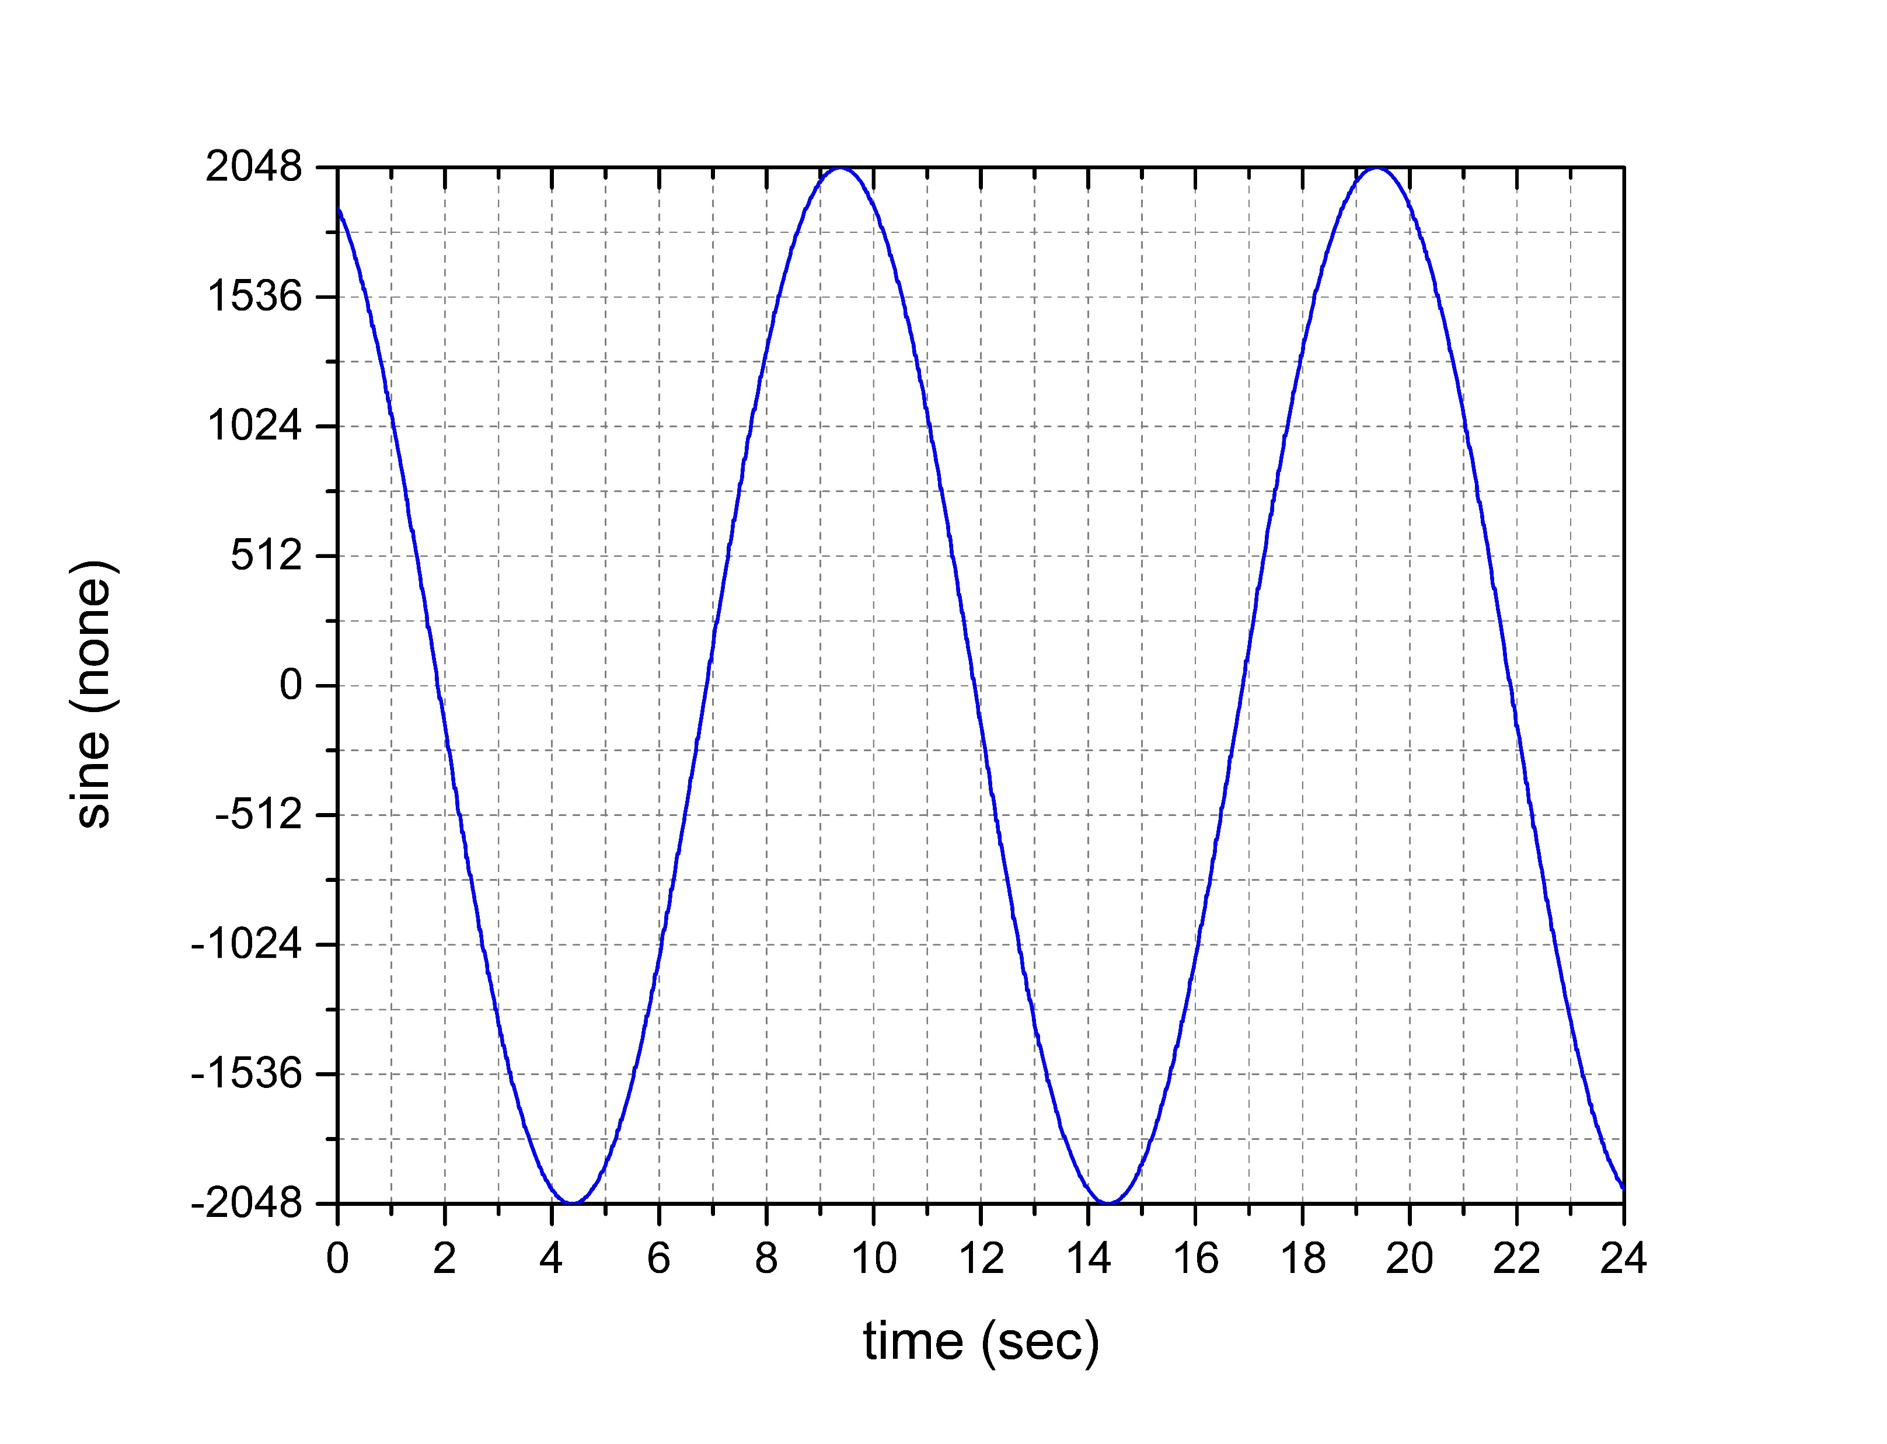
Phased timers – Why?

Slide 6
Phased timers – Why?
But zooming in, we see there are points on the plot where the same value was recorded twice when ‘floger’ captured data before ‘compvar’ updated the sine wave variable.
There are also points where ‘compvar‘ “caught up” and updated the sine wave variable twice before floger had a chance to record the first update of the variable.

Slide 7
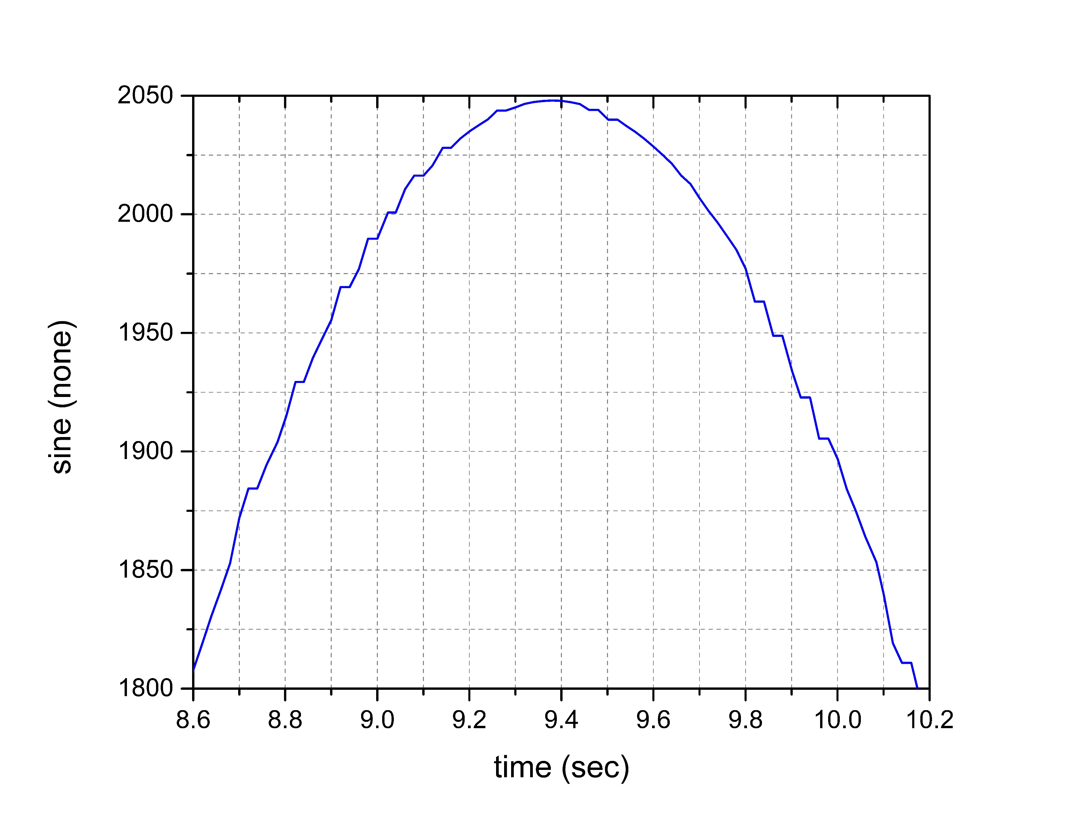
Phased timers – Why?

Slide 8
Phased timers – Why?
Even worse is the effect inconsistent processing order has on the ‘run_aver’ task.
‘run_aver’ uses the timestamp of the variable it is sampling to determine if it has updated and throws away points that appear to be duplicates. So every point that appeared as a flat spot on the ‘floger’ plot would have been thrown out.
It will also fail to capture points that get updated twice before ‘run_aver’ can capture the data.

Slide 9
Phased timers – Why?
We aren’t really taking advantage of more powerful processors if we restrict real-time applications to 1 CPU , so we need another method to control sequence of operations.
We can control the sequence by generating timer events that have a delay, thus giving application A time to complete its operation before application B is signaled to run, even though A&B are running at the same priority and same process interval. The ‘delay’ should be large enough to allow A to complete.

Slide 10
Phased timers – Implementation?
The ‘scheduler’ application creates the new phased timers, but they don’t require command line arguments. They are created automatically.
One additional argument has been added to set the size of the phase shift (delay). PHASING=<size>
Example: scheduler PRI=21 WARP=2 FAS=20 MED=100 SLO=1000 PHASING=1 &

Slide 11
Phased timers – How To USE?
The PHASING ‘size’ value determines the phase shift based on a multiple of the smallest timer interval specified in the launch of the event administrator in the go.scp
Example: evnt_adm 1000 2 & ^-smallest timer[ms]
PHASING size can be 0, 1, 2, 3, etc.
Default PHASING size is ‘1’

Slide 12
Phased timers – How To USE?
There are 3 phased timers for FAS, MED, and SLO
  FAS1 – 1 * size_of_smallest interval
  FAS2 – 2 * size_of_smallest_interval
  FAS3 – 3 * size_of_smallest_interval
  MED1 – 1 * size_of_smallest_interval
  Etc. for MED1,2,3, SLO1,2,3

Slide 13
Phased timers – Selecting phases?
CyFlex applications that support the standard timers have been modified in 6.3.0 to support the phased timers.
  FAS, FAS1, FAS2, FAS3
  MED, MED1, MED2, MED3
  SLO, SLO1, SLO2, SLO3
Timer names can be used for other applications
  tmr-20, ptmr1-20, ptmr2-20,ptrm3-20
  tmr-100, ptrm1-100, ptrm2-100, ptrm3-100
  tmr-1000, ptrm1-1000, ptrm2-1000, ptmr3-1000

Slide 14
Phased timers – Selecting phases?
Examples:
  ai_transfer 18 FAS &
  ai_transfer 17 MED &
  user_ctrl_task 15 MED2 &
  ao_transfer 18 FAS3 &
  gas_prop 12 SLO1 &

Slide 15
PHAsed timers – Selecting phases
Standard timer names (FAS, FAS1, etc.) can be used in specification files just like FAS, MED, SLO are now.
Where timer names such as “tmr-20” are using in specification files such as er_specs, the phased timer names can be used, as well

Slide 16
PHAsed timers – Selecting phases
Examples for er_specs:
  @INPUT_EVENT
  tmr-20
  ….
  @INPUT_EVENT
  ptmr1-20
  (processed 1 phase later)

Slide 17
Phased timers – Timer storms?
SPECIAL CASE: new relationship of standard timers, WARP, FAS, MED, SLO
Prior to cyflex.6.3.0, these timers always lined up to occur at the same time.
For FAS=10 MED=100 SLO=1000
Every second (1000ms), all three timer events would occur simultaneously.
In between the 1000[ms] timers, every 100[ms] the FAS and MED timers would line up

Slide 18
Phased timers – Timer storms?
When these timer events all happen at the same time, we call that a “timer storm”.
For this example case, every application that uses FAS, MED, or SLO would be activated and will be competing for CPU time based on priorities and cpu availability. In multi-core systems, who gets to run first is unpredictable

Slide 19
Phased timers – Why?
A utility called test_ev_time allows us to check the time at which timer events are actually acted upon and compare it to the ideal.
Data captured for a 2 ms timer event shows periodic delays in responding to the timer that suggest that periodic high cpu loads exist that are consistent with a timer storm.

Slide 20
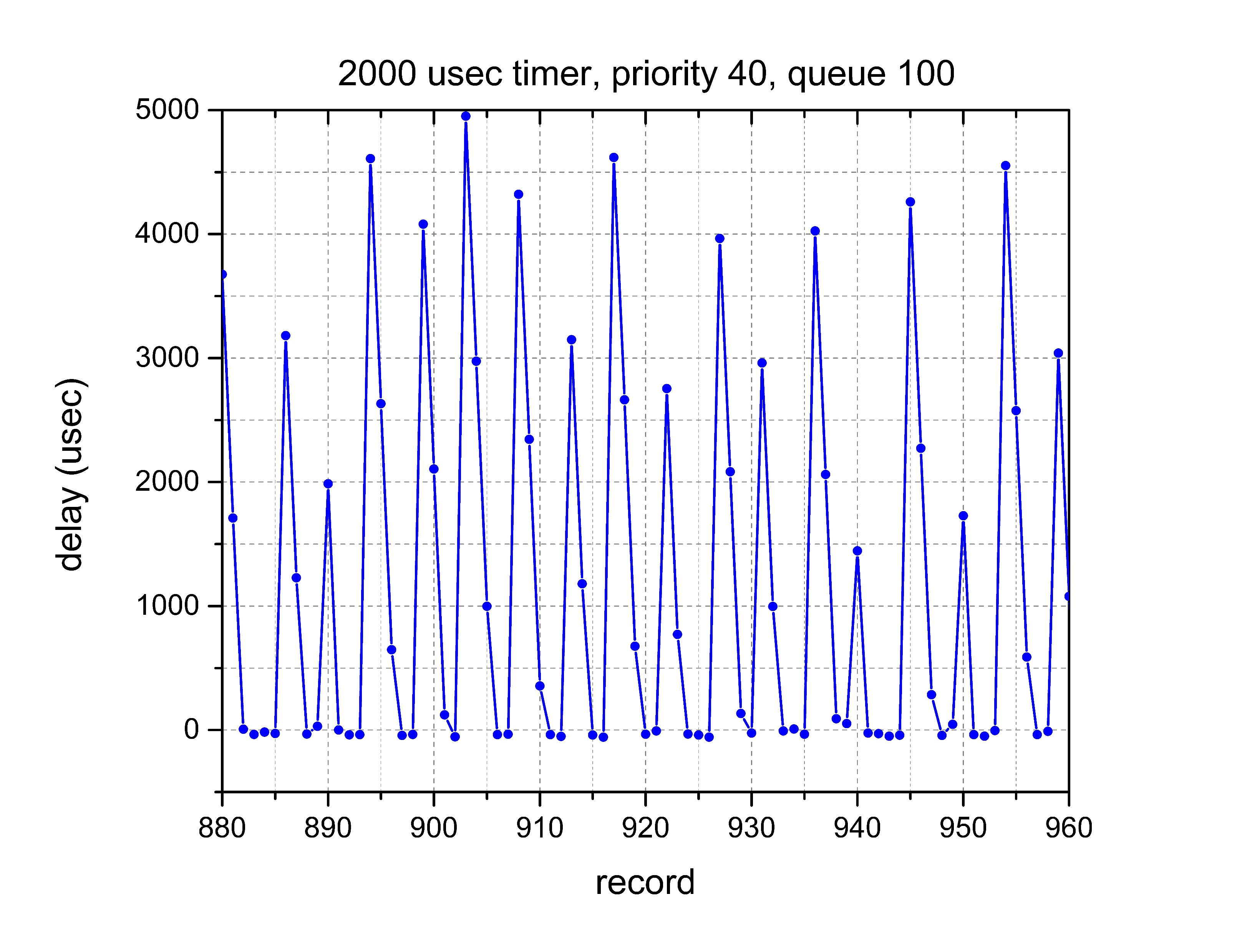
Phased timers – Why?

Slide 21
Phased timers – Timer storms?
In cyflex.6.3.0, the event administrator was modified to allow the shifting of events so that the timer storms can be minimized.
The events for FAS, MED, and SLO will never line up to occur at the same time, regardless of the PHASING value.

Slide 22
Phased timers – Timer storms?
“timer storms” can result in “overruns”. An “overrun” is a case where an application is not able to complete its process before it receives another timer event.
The ‘scheduler’ application keeps track of overruns and has a limiting value for every application and will report an error message if the limit is exceeded. If the application is ‘critical’ the ‘watchdog’ is suspended.
The ‘ms_diag’ utility shows the current state of overruns.

