Slide 1
CYFLEX.COM
A collaborative portal for user information sharing
By: Your Transportation Laboratories Partners
October 7th, 2019
Notes:
PRESENTER: MVH

Slide 2
AGENDA
Why CyFlex.com?
“Did you Know?” (manage subscription)
Searchable Manuals
“Usage Help” Repository by Version
Release Information
FAQ’s
How to get help
What would you like to see on CyFlex.com?
Q&A’s
Notes:
PRESENTER: MVH

Slide 3
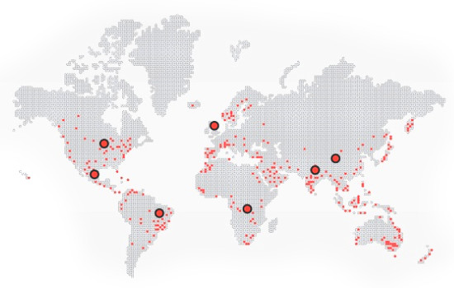
WHY CyFLEX.com?
Innovation is being driven from CyFlex’s “flexibility”
around the world.
TRP Labs wanted to develop a
Platform to share knowledge,
ideas, and “at your fingertips”
support.
We hope you will share your great ideas with users across the globe!
Notes:
PRESENTER: MVH

Slide 4

DiD YOU KNOW?
Regularly, TRP Labs sends an email to subscribers that we call “Did You Know?”.
On CyFlex.com, you can search for previous “Did You Know?” topics and manage your subscription.
If there is a specific topic you’d like shared, please contact TRP Labs Software Process Manager: Jen Schuck
Jennifer.Schuck@trplabs.com
Notes:
PRESENTER: MVH

Slide 5
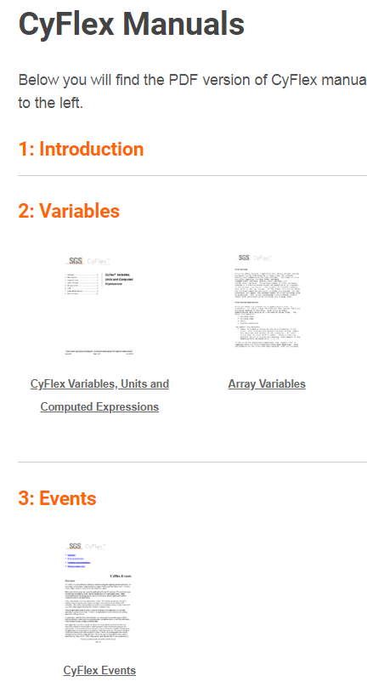
SEARCHABLE MANUALS
CyFlex.com has the latest and greatest CyFlex Manuals in PDF form.
The manuals are full-text search and organized by Chapters:
http://cyflex.com/cyflex-manuals/
Notes:
PRESENTER: MVH

Slide 6
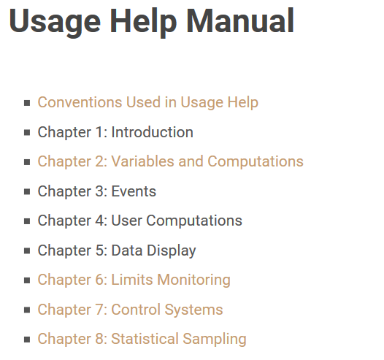
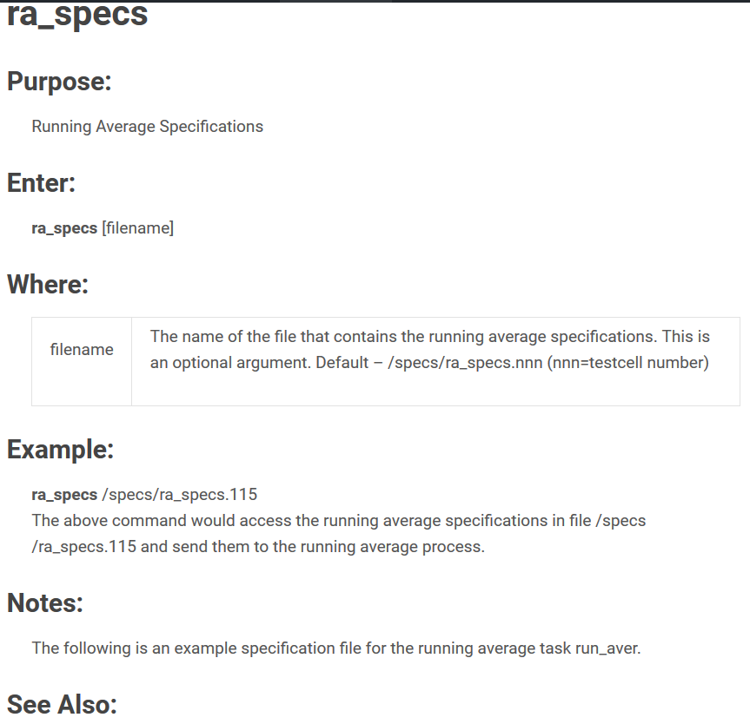
“Usage Help” Repository by Version
CyFlex.com has each of the over 700 user commands documented with usage examples.
These are full-text searchable and version controlled!
Notes:
PRESENTER: MVH

Slide 7
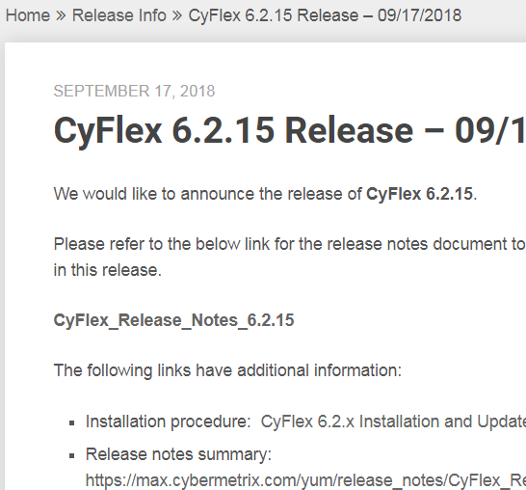
Release Information
Everything you need to know when TRP Labs announces a new CyFlex release
Search for previous releases
Find all related JIRA issues in release
Find out about new features and/or bug fixes
Notes:
PRESENTER: MVH

Slide 8
HOW TO GET HELP
TRP Labs IS HERE TO HELP
TRP Labs Assistance Methods
Via JIRA Issue System: https://max.cybermetrix.com/jira
(if you do not have a JIRA ID, contact Jennifer Schuck at Jennifer.schuck@trplabs.com)
Via Email: cyflex.support@trplabs.com
Via Phone: +1 812 378 5903 – “CyFlex Support”
Via After-Hours Hotline: +1 248 242 7231
Notes:
PRESENTER: MVH

Slide 9

YOUR INPUT REQUEStED
We want to hear your ideas!
How can we continue to develop CyFlex.com for your benefit?
Notes:
PRESENTER: MVH

Slide 10

QUESTIONS
&
ANSWERS

Slide 11
END

