Slide 1
DARTS
Presented by Justin Jaworski

Slide 2
What is DARTS
DARTS(Data Analysis ReposiTory System) is a new Oracle database like the PAM database. DARTS provides a comprehensive database and analysis for engine test data. Its primary data format is for “Fuel Readings”, but also can hold Logger, Indicom, RAPID, and .ecfg data. DARTS is also much more robust than PAM, and has additional features outside of CyFlex

Slide 3
Why the Need for DARTS
The purpose of DARTS is to address some long-time user needs which has been exceedingly difficult to store within PAM.
There are current processes to do workarounds for the PAM system limitations. The workarounds work for the immediate data consumers but are a hassle to setup and use. However, they are highly problematic for secondary consumers and can relegate the data as useless to them.

Slide 4
Why the Need for DARTS: ECM Keywords
Current process is to store ECM parameters into PAM keywords like USER15@5 and changing the unit to a PAM supported one or NONE. The user then remaps the keywords/units after data extraction.
A stop gap was placed within PAM by adding keywords prefixed by ECM_ (which avoids any naming clashes with existing keywords). However, this approach is not sustainable due to additional ECM parameters that would be needed as well as the mismatch of PAM versus ECM units still existed.

Slide 5
Why the Need for DARTS:AUX Keywords
Just as with ECM parameters, the current processes use the PAM USER keywords which are not descriptive. There can also be an issue with unsupported PAM units as well. The user then remaps the keywords/units after data extraction. A new set of user-defined “auxiliary user” keywords will be supported.

Slide 6
When is DARTS Coming
DARTS is already here. Almost all test cells are currently sending data to both PAM and DARTS.
Systems that are already sending to PAM have their data files duplicated and sent to the DARTS database
There will be dedicated DARTS CyFlex tasks such as ‘darts_datapoint’, 'setDARTStestid’, and 'dlogger' coming in 6.3.0

Slide 7
How Darts is Working Now
Once data files are sent from the test cell to the central node, the data files are duplicated from the original directories into a new DARTS directory
For example PAM datapoints in /data/transfer/PAM_datapoint will be duplicated by DARTS into a new directory called /data/darts_pam/ and sent to DARTS

Slide 8
What to Expect
As mentioned earlier, some PAM tasks are getting DARTS versions. Here is a list of PAM to DARTS CyFlex tasks:
datapoint -> darts_datapoint
setPAMtestid -> setDARTStestid
setPAMpoint -> setDARTSpoint
pam_specs -> darts_specs
pamStatus -> dartsStatus
pamResend -> dartsResend
changeKeyword -> changeDartsKeyword
changeTestidPtAll -> changeDartsTestidPtAll
PAMheader -> no equivalent, not needed
Basically, if there was a PAM version, there should be an equivalent DARTS version, or is now obsolete.

Slide 9
What to Expect
In the 'go' script, ‘pam_specs’ and ‘PAMheader’ should be removed and ‘datapoint’ should be replaced with ‘darts_datapoint’
The format of the specfile for ‘darts_datapoint’ is different than 'datapoint'. So you will need to convert the ‘/specs/pam_specs.xxx’ into a new ‘/specs/darts_specs.xxx’ file
There is also a new logger task called ‘dlogger’ that formats for DARTS and has an editor task called ‘dloggereditor’ that generates the input files for 'dlogger'

Slide 10
What to Expect
Most cells already have the '/specs/transfer_specs' file updated, but you should make sure that data movement is correct. You will eventually remove the PAM section form this file as well.
# Transfer Type
DARTS datapoint
# Source: Ready Complete
/data/transfer/darts_datapoint /data/darts_datapoint
# Destination:
# Node Path
$NODE /data/darts_pam/PAMdatapoint/ready/$TC/

Slide 11
darts_datapoint
Unlike the previous datapoint task, darts_datapoint only requires datapoint files to be transferred, instead of both datapoint and header files. It now puts the “PAM header” information into the datapoint file itself. The new ‘darts_datapoint’ task will use 2 different files. A ‘/specs/darts_specs.xxx’ file and a ‘cell/darts_fixed.xxx’ file.
The ‘darts_specs.xxx’ file will extend the behavior of the '/specs/pam_specs' file and add 2 more sections, one for ECM Parameters and another for Auxiliary User Keywords
The ‘/cell/darts_fixed.xxx’ file is regarded as a test cell configuration file versus a test set up file like engine_specs. The darts_fixed file is not anticipated to be modified after CyFlex is set up at a test cell. The contents of the darts_fixed file should contain mandatory keywords that are required by DARTS to accept the datapoint files.

Slide 12
Sample darts_specs.xxx file
# DARTS Steady State Specs
$Type
DARTS_SS_SPECS
$FormatRev
REV01
$DartsHeader
# TestID testid extension
myTestID ctc
$Measured
# Label Averaging DARTS Keywords (0-4)
# Note: DARTS keywords are case-sensitive and must be all caps exh_stk_p AVER TUR_OT_P
fpmp_in_p AVER FPMP_IN_P
barometer AVER BAROMETER SAE_REF_PA

Slide 13
Sample darts_specs.xxx file cont.
$ECM
# Label Averaging Stored_Channel_Names (0-4)
# Note: Stored_Channel_Names are arbitrary but must not conflict with
# ECM 0 data source
Accelerator_Pedal_Position SNAP
ECM_Run_Time SNAP
# ECM 1 data source
Accelerator_Pedal_Position_1 SNAP Accelerator_Pedal_Position@1
# Note: The _1 in the label name below is user-provided/managed ECM_Run_Time_1 SNAP ECM_Run_Time@1
$AuxUser
# Label Averaging Stored_Channel_Names (0-4)
# Note: Stored_Channel_Names are arbitrary but must not conflict with
# Standard keywords
press_1 AVER Instr_Press@1
press_2 AVER Instr_Press@2

Slide 14
Converting pam_specs.xxx to darts_specs.xxx
$PAMHeader -> $DartsHeader
    This converts perfectly between versions
$PAMDatapoint -> $Measured
    Everything in $PAMDatapoint should go to the darts_specs '$Measured' section except for a few differences
    Any keywords prefixed by ECM_ should be placed in the '$ECM' section. Ex: active_faults AVER ECM_ACTIVE_FAULTS
    Any keywords that use 'USERXX@XX' as their keyword should be placed in the '$AuxUser' section.
    Ex: ext_ot_p AVER USER12@1

Slide 15
Sample darts_fixed.xxx file
# The darts_fixed file specifies data to be included in the
# $FixedMetaData section of the darts_datapoint and dlogger output files.
# The default path is: /cell/darts_fixed.<cell_name>
$Type
DARTS_SS_FIXED
$OutputPath
/data/transfer/darts_datapoint
$FormatRev
REV01
# The keywords represent CyFlex labels that are mandatory to send # datapoints to DARTS.
$Keywords
#<CyFlex label> <DARTS keyword>
program PROGRAM #Required
tpid TEST_ID #Required
test_type TEST_TYPE #Required
MODE MODE #Required
group GROUP #Required
site SITE
tc TESTCELL
$END

Slide 16
dloggereditor
The dloggereditor is a new utility GUI that creates the specfile to be used with the new 'dlogger' task.
Being a GUI, it is less error prone and shows all the possible options real time and gives tooltips for keywords
It is quicker and easier to create a specfile for the 'dlogger' task

Slide 17
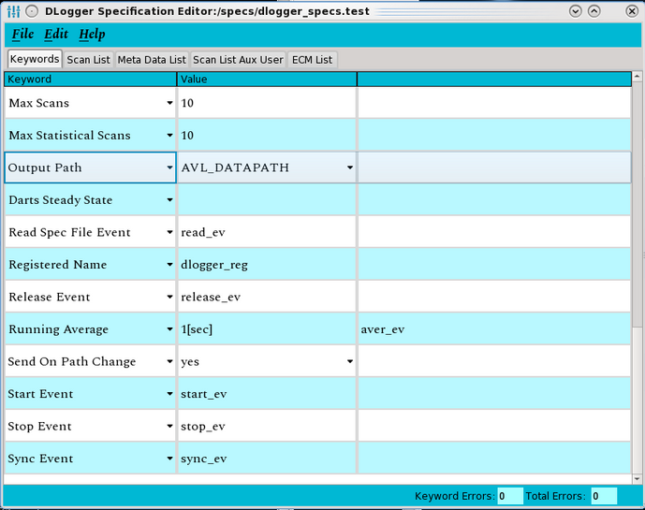
dloggereditor

Slide 18
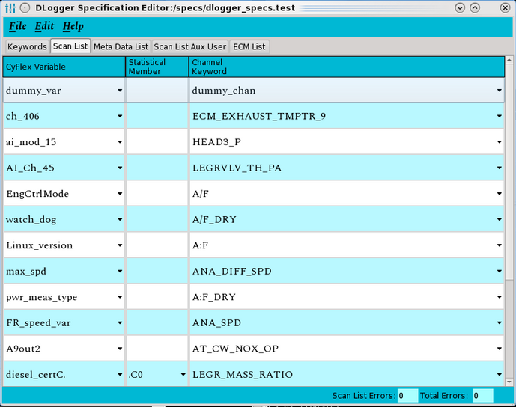
dloggereditor

Slide 19
dlogger
'dlogger' is very similar to other logger tasks like 'flogger' but with updates to be compatible with the DARTS database. It adds sections for $AuxUser and $ECM like for the 'darts_datapoint'.
dlogger also automatically sends logger data to the DARTS database.
dlogger also allows RAPID capabilities to be used

