Slide 1

CyFlex Training
PID Control Systems

Slide 2
PID Control Overview
The most common algorithm used in industry
A sensor value is read and compared to the desired value
The difference is multiplied by P, I, and D gains to find output terms
The sum of the terms is sent to an output device to eliminate the error
The process is repeated over and over

Slide 3
Typical Controllers
Typical industrial controllers attempt to maintain a temperature, pressure, or flow rate.
  Many different types of devices are manipulated.
  Valves, heaters, coolers, flow dampers, etc.
Engine controllers attempt to maintain speed and torque settings.
  Speed can be controlled with the throttle to increase or decrease output.
  Speed can also be controlled by modulating the torque of a dyn0.
  Engine torque is controlled by manipulating the other of these two variables.

Slide 4

PID Controllers
Defining u(t) as the controller output
Where:
  MV(t) is the manipulated variable
  Kp = Proportion gain
  Ki = Integral gain
  Kd = Derivative gain
  e = error = setpoint – feedback value
  t = time (present)
  τ = variable of integration – takes values from time = 0 until the present time.

Slide 5
Proportional Term
A high proportional gain gives a large output for a given error.
A proportional term ONLY exists if there is an error in the system
A P-only controller will not eliminate steady state error.

Slide 6

Integral Term
The integral term represents the accumulation of errors over time
The value of the integral term will keep changing until the error goes to zero.

Slide 7

Derivative Term
The derivative term represents the rate of change of the error.
When the error is not changing, the derivative term will go to zero
The derivative term may become unusable if the feedback is noisy

Slide 8
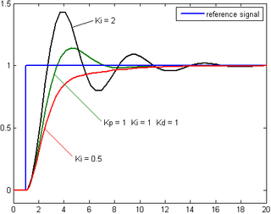
General Effect of Gains
Affect of various I gains when P and D gains are constant

Slide 9
CyFlex Implementation of Controls
General purpose user controls
  Air and fuel flow systems
  Cooling systems
  Single loop or cascaded controls where one loop outputs the setpoint for another loop.
Engine control systems
  Speed control
  Torque control
  Manipulation of the engine throttle (fueling)
  One or two dynamometers to absorb load

Slide 10
Setting the Desired Value
The desired value is known as the loop target
Set the target with:
  CyFlex commands
  gp_test
  Control display GUI
The target may be bounded
The target may be ramped from the existing value to a new one
The present target is known as the reference value and will become the target value when ramping is completed.

Slide 11

Calculating the Loop Error
Error = Set Point – Actual
Or
Error = Loop Reference – Feedback Value
Determines the sign of the gains
The output will increase when the setpoint is above the present value if the gains are positive
The output will decrease when the setpoint is above the present value if the gains are negative

Slide 12
CyFlex Implementation of Controls – Setting the Desired Value

Slide 13
Calculating the PID Output
The error can be scaled by the value of another CyFlex variable that the user can manipulate
The integral term can be bounded to avoid unreasonable values if the error doesn’t go to zero.

Slide 14
Gain Scaling Example
If you want a higher gain at high speed
  Minimum gain for low speed
  Double that gain at high speed
  Gain_scale = min_gain + speed/ra_spd * min_gain
The multiplier could be the result of a:
  Computed expression
  Table lookup
  Flow valve characteristics

Slide 15
Using Feedforward
A user model can be developed to set the output very close to the correct value.
The PI&D controls can then be used to correct for inaccuracies in the model

Slide 16
Controller Output Adjustments
Hysteresis compensates for actuator wear or sticky controllers
Bounds can be placed on the output to represent real world limits.

Slide 17
Controller Output Adjustments
A command map can be used to compensate for non-linear systems

Slide 18
Open and Closed Loop Operation
Sometimes the user just wants to set a specific command rather than accept a closed loop calculation.
This accomplished by setting the controller to open loop.

Slide 19
Manual Control (Legacy Option)
Sometimes the system is so non-linear that manual setting is required

Slide 20
Automatic Gain Tuning
An option is provided that will find optimum P, I, & D gains
This works very well on well-behaved systems
The auto-tuning process is easy to start from the control display GUI
Need user feedback on when to turn this feature on

Slide 21
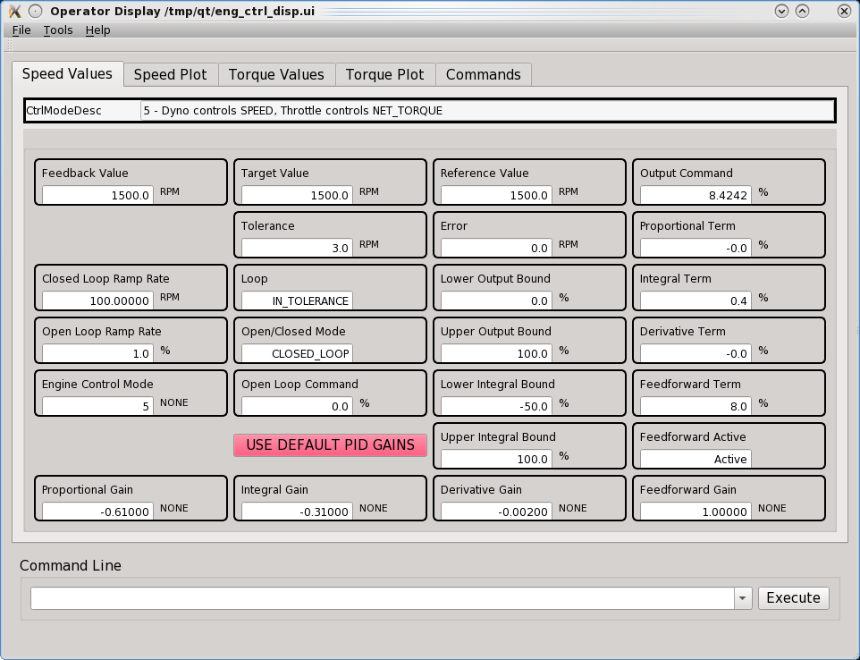
Control Display GUI
Launch with ctrl_disp for engine loops
ctrl_disp loop_name for user loops

Slide 22
Control Specification Files
One format for user controls
  Temperatures, pressures, flows, etc
  One or more loops specified per file
  Launch with:
  user_ctrl_specs [filename] [loopname]
A separate file for engine controls
  Similar format with more options
  Dyno and throttle control
  Launch with:
  eng_ctrl_specs filename
Both specification processors launch the necessary control programs
  Multiple instances for user loops

