Slide 1
CYFLEX 6.3.0 Features & Updates
By: Your Transportation Laboratories Partners
October 15th, 2018
Notes:
PRESENTER: MVH

Slide 2
OVERVIEW
www.cyflex.com – Additional Presentation
New Gantner & Snapio Drivers
New Modbus driver – how to install and configure
New Ethercat driver – devices it supports
Compressed History - frequency driven – tunable
System Status Log – what it logs – how to retrieve information – where installed
Error manager database – how does it differ from old method
gp_test improvements – finer time resolution – new keyword @CHAIN_EVENTS
64-bit OS – Additional Presentation
Phased timers – Additional Presentation
user control tasks
Changes to New engine array variables (units variable by member)
ESVD feature changes
QT5 – Additional Presentation
ODOR (mercaptan) composition members and related handling.
Notes:
PRESENTER: MVH

Slide 3
Gantner and Snapio Driver Improvements
Reduced latency between CyFlex and the driver analog inputs
Removed hard limits in our Snapio driver
Gantner and Snapio drivers no longer rely on timer events. Direct signaling is now used.
Snapio is now about 47% faster
Gantner is now about 54% faster.
Nothing must be done by the user, the improvements are on by default
User may want to update 'ao_transfer' and 'do_logi_xfer' in their go scripts to make sure they run as fast as 'ai_transfer'
Notes:
PRESENTER: MVH

Slide 4
New Modbus driver
New driver using the modbus protocol
Unlike 'gmodbus', this new task has all the benefits of a CyFlex driver. Such as calibration tables
Has both serial and TCP interfaces
Same setup as other CyFlex drivers, such as Gantner and Snapio
Notes:
PRESENTER: MVH

Slide 5
New Ethercat driver
New driver using the ethercat protocol
Faster than general TCP/IP
Useable by new Gantner stations
Many new devices adding this protocol
Notes:
PRESENTER: MVH

Slide 6
COmpressed History
Data collection rates are greatly reduced, thereby reducing disk activity and disk size requirement
Collection rate is controlled by frequency of variable change, but limited by user tunable parameters
Collection rate for integer variables also frequency limited
Notes:
PRESENTER: MVH

Slide 7
CYFLEX SYSTEM STATUS LOG
A set of applications for collecting data on CyFlex applications and the hardware at each cell.
The collected data is upload hourly to a Cummins database.
Data collected:
When a Go is started
Watchdog triggered by application
When a system is rebooted
When an application or script is started
Specfiles read
Hardware Configuration
The data is used to identify problems or improvements.
Notes:
PRESENTER: MVH

Slide 8
Error manager database
The error manager has been modified to use a local database
Errors from past go's can be recovered
Better potential for filtering errors in the future
Potential for new applications with better integration
Notes:
PRESENTER: MVH

Slide 9
Test Scheduler (gp_test)
Timer resolution was 10[ms] in 6.2.x. In 6.3.x, timer resolution will be 10[ms] or WARP interval, whichever is faster
New @CHAIN_EVENTS keyword has been added to support features similar to @FUEL_READING_SYNC, but in test modes that are not taking a fuel reading
Notes:
PRESENTER: MVH

Slide 10
New engine and user control tasks
Separate programs for engine and user control loops
Each user loop is maintained with a separate instance of the program
No program is suspended when the specification files are processed
Control programs are launched automatically by the user and engine control specs programs
All specifications use keyword format
All previous control commands are supported plus more
Notes:
PRESENTER: MVH

Slide 11
New engine and user control tasks
Almost all inputs can now be values, labels, or expressions
Once internal values are now live and can be read and changed on the fly – caution advised
Programs are in use at TRP Labs and in beta testing at Cummins
Notes:
PRESENTER: MVH

Slide 12
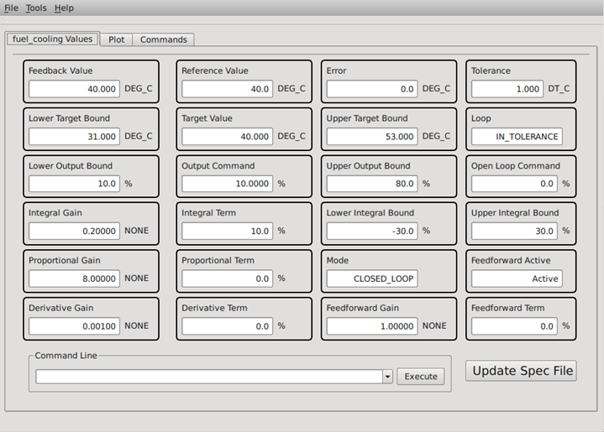
New control Display task
A new QT based control display shows important values
All input values can be changed from the screen
Gains can be updated on the fly
New gains can be written to the disk along with comments and a log book entry
Loop auto-tuning in beta testing
The display can be easily modified per user feedback
Notes:
PRESENTER: MVH

Slide 13
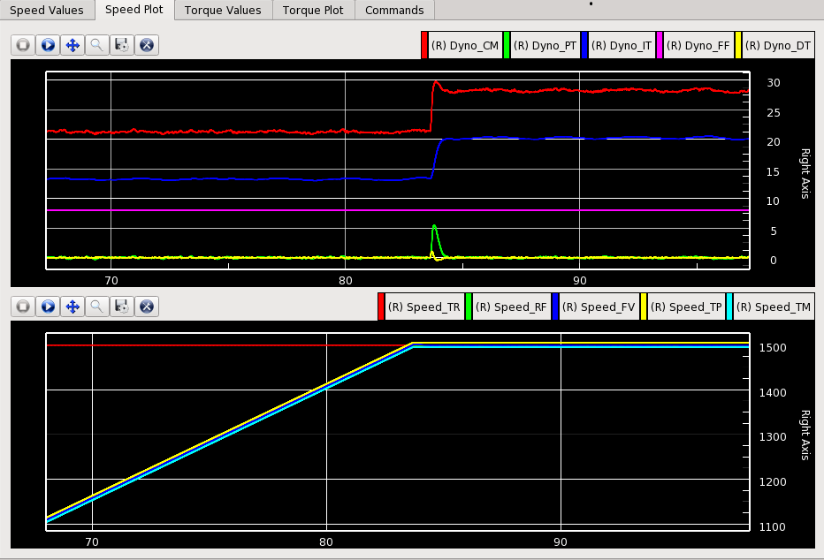
New control Display task
A new QT based control display shows real time plots
All terms, commands, target, and reference displayed
The upper and lower tolerance values are always shown to easily judge quality
Scaling is automatic, so nothing is lost from sight
Notes:
PRESENTER: MVH

Slide 14
Changes to array variables
All elements of an array variable had to have the same units in earlier versions
Each element can have different units in 6.3 but all are initialized the same
Use sarru to change the units for an individual element
Example => sarru my_arr:4 psi
Notes:
PRESENTER: MVH

Slide 15
ESVD fUture changes
Array variables can be created for all values in cvs_specs.dat
New versions of TCA and ECG are coming
Changes are in progress for TRS (Test Request Suite)
Pacing of development is determined by Cummins
Notes:
PRESENTER: MVH

Slide 16
ODOR (mercaptan) composition members
Mercaptan odor measurement device now supported
Monitors the following components
Hydrogen Sulfide
Methyl Mercaptan
Ethyl Mercaptan
Dimethyl Sulfide
2-Propyl Mecaptan
Butyl Mercaptan
Methyl Ethyl Sulfide
1-Propyl Mercaptan
2-Butly Mercaptan
Diethyl Sulfide
TetraHydroThiophene
Components added to the CyFlex composition variable structure
Notes:
PRESENTER: MVH

Slide 17
QUESTIONS & ANSWERS

Slide 18
END

