Slide 1
CyFlex troubleshooting tools

Slide 2
DISCLAIMER
The information in this presentation is provided to all users of CyFlex. Please do not share this information to individuals not directly related to the use of CyFlex. Additionally, at lunch and learn events, there are multiple companies on this call and not all companies have non-disclosure agreements (NDA) with each other. Because of this, all participants should be careful to not share any proprietary information.

Slide 3
Meet the presenter
I am Adam Watson, the first line of JIRA defense
Mechanical engineer with 8 years CyFlexing
I’ve commissioned test cells and other CyFlex Systems at RMTC, JTC, CTCC, Walesboro Noise Lab, Stoughton, STC and CTC over the years.
Used to work out of Columbus, now located in Colorado
Microsoft gives you Windows, Linux gives you the whole house... but you may still need to hire a plumber now and then

Slide 4
Troubleshooting: What is the goal?
The troubleshooting goal is not to fix the problem, it is to identify the problem (…and then fix it)
Is it CyFlex (bug or configuration issue)?
Is it the device (IO, AVL device, etc)
Does the device software (test.commander, PAC Manager, etc) indicate a problem?
Is it the cable between CyFlex and the device?
Is it the computer?
When does it happen?
Only on startup?
Only when I run the _____ command?
Only when the ______ does the _______?
Every day at 1AM
Every time we’re in gp_test mode 444?
Define the history
“The system has sat in a vacuum sealed chamber for 19 years. Nobody touched it all that time. It worked for 19 years. I updated inpt_specs and the analog inputs stopped working.”
Your edits might be related to the problem
This background information being included in the JIRA will result in a quicker resolution of your problem

Slide 5
JIRA resolution - Why are we playing 21 questions?
We resolve JIRA’s by defining the problem as one of the following
A software bug
If possible, define and recreate/reproduce bug on our systems so developer can fix it
If it is hardware specific, try to reproduce on customer system so developer can fix it
A user error because the user didn’t read the instructions
Reference documentation
Guide the user through configuration
Reference another functional cell
A user error because the instructions were lacking, misleading, incorrect, or didn’t exist
Resolve issue for customer
Update documentation
Answers to everything in the previous slide generally will determine which of these is the root issue.
“Could you check __________?”

Slide 6
Overview
CyFlex tools:
Variable Values
gvar
gval
dumpit
fdump
watch
Events
events (the command)
evnt_info
Errors
errs
event trace files
gp_test trace files
show_mem
ms_diag
/cyflex/specs.def and cell.def comparison
go.scp!!! The order matters!!!
go.scp!!! The order… it matters!!!
Computer tools:
/var/log/messages
top
ifconfig
diff / meld
/usr/local/bin/analyze-cores
tcpdump
grep

Slide 7
gvar
Get a variable value ( and so much more! )
units
update time
Is it updating? Should it be? Was it ever updated?
Who is updating it? Should they be? Is it changing? Are multiple people updating it?
watch -n.1 gvar
How quickly is it changing value?
Digital inputs: svar then gvar
Does it say updated by svar or di_logi_xfer?
If the variable is only updated when a translator is run (like gen_labels, but not compvar), then there may be an error with the application, or with your calculation within gen_labels

Slide 8
gvar
[tc1@awatson ~]$ gvar gmod_ai6
gmod_ai6 = 37224448 mv status=NO, mem.index=206
last_update_time = Mon May 15 12:23:18 2023
by <457300>ai_transfer
[tc1@awatson ~]$ watch -n1 gvar gmod_ai6
[tc1@awatson ~]$ watch -n.1 gvar gmod_ai6
[tc1@awatson ~]$ watch -n.1 "gvar gmod_ai6;date“
[tc1@awatson ~]$ gvar avl_smoke
avl_smoke = 0.0 BOSCH status=NO, mem.index=18
last_update_time = NOT_UPDATED

Slide 9
gvar
[tc1@awatson cmds]$ gvar temp_a;date;gen_labels;gvar temp_a
temp_a = 1.0 deg_c status=NO, mem.index=50
last_update_time = Mon May 15 13:05:36 2023
by <469214>gen_labels
Mon May 15 13:06:52 MDT 2023
gen_labels is using /specs/gen_labels.1
temp_a = 1.0 deg_c status=NO, mem.index=50
last_update_time = Mon May 15 13:06:52 2023
by <469380>gen_labels

Slide 10
gval
Dumbed down gvar that only returns the value
Useful for bash scripting – commonly used for diagnostic and CVS scripts
Example:
tpid=`/cyflex/bin/gval tpid`
map=`/cyflex/bin/gval map`
step=`/cyflex/bin/gval step`
runno=`/cyflex/bin/gval RFMRunno`
runnoPrev=`/cyflex/bin/gval PrevRunNo`
operComm=`/cyflex/bin/gval operComment`
cycleName=`/cyflex/bin/gval cycle_name`
cellnum=`/cyflex/bin/gval cell_number`
cycleType=`/cyflex/bin/gval cycle_type`
activity=`gval activity_name`

Slide 11
dumpit
Snapshot of all variable values
Are AI’s updating?
Find out who owns a variable
Quickly see calculations
Depending on variable naming scheme, this can give very quick updates
dumpit TCSDyn
For many Unico cells, this will show you ‘most’ of the dyno related IO variables
dumpit Throttle_
see all the throttle control loop variables
dumpit fueltank_
See all fueltank_wt control loop variables
dumpit test_var
dump_it
Same but piped to a less session.
Good to peruse an evaluate the overall health of a system
dumpit | grep subsonic
Sometimes useful over fdump

Slide 12
dumpit
[tc1@awatson cmds]$ dumpit IntRestDutyCycle
GENERAL USE REAL VARIABLES
index label value units tol owner last_update
21 IntRestDutyCycle
0.0 % 0.099 Compvar compvar
COMPUTED VARIABLES - value result
target_variable event owner expression
0 IntRestDutyCycle
tmr-1000 Compvar
"(( IntRestOnT - IntRestOnTlast ) / 5[sec]) * 100[%]"
COMPUTED VARIABLES - status result
target_variable event owner expression

Slide 13
fdump
Similar to dumpit, but with many arguments to refine the results
type ‘use fdump’ to review all of them
Useful examples
fdump +dt
Show detailed update time
fdump -v -u Throttle
Dump a list of all the Throttle variables to the terminal.
Useful for creating logger files for control loops or other variables with common string matching patterns
fdump n=0.05[sec]
Show variables newer than 0.05[sec]. This excludes values which are not updating.
fdump d=psi
In a standard unit cell, this will (mostly) show you all your pressure inputs
fdump owner=CanDbc
Show all the variables created by CanDbc

Slide 14
events
[tc1@awatson log]$ events
Type in event name followed by <Enter.>
Enter a period "." to end list.
FR_IP
FR_RQST
.
event_name event_id hex/dec time sender pid,name
FR_IP 2000017/33554455 09:09:52.206 pid=533152,dummy_fr
FR_IP 2000017/33554455 09:09:57.203 pid=533152,dummy_fr
[tc1@awatson cell]$ events_auto
Type in event name followed by <Enter.>
Enter a period "." to end list.
event_name event_id hex/dec time sender pid,name
tst_event 20000a2/33554594 09:24:57.538 pid=535715,setev^C
[tc1@awatson cell]$ cat /specs/cmds/events_auto
#!/bin/bash
printf "tst_event\nFR_IP\nFR_RQST\n.\n" | events

Slide 15
events
[tc1@awatson specs]$ events < /specs/events
Type in event name followed by <Enter.>
Enter a period "." to end list.
event_name event_id hex/dec time sender pid,name
tst_event 20000a2/33554594 09:21:49.275 pid=535129,setev
[tc1@awatson specs]$ cat events
tst_event
FR_IP
FR_RQST
.

Slide 16
events
[tc1@awatson cell]$ events n=5
Type in event name followed by <Enter.>
Enter a period "." to end list.
ai_modbus_tran
.
Log complete.
Maximum number of events logged.
Number logged by event.
Name: ai_modbus_tran Eid=200003d Number Logged: 5
Event Log.
#/total Event Name EID ms #/event
0 ai_modbus_tran 200003d 1
1 ai_modbus_tran 200003d 2
2 ai_modbus_tran 200003d 3
3 ai_modbus_tran 200003d 4
4 ai_modbus_tran 200003d 5

Slide 17
events
Important CyFlex events
abort_limit
special event containing special information and used by many applications for controlled shutdowns
ai_modbus_tran, ai_snapio_tran, ai_eblox_tran, ai_ecat_tran
events used by ai_transfer to update analog inputs
You can see the rate your AI’s will update by monitoring this event using the events command
emergency
special event containing special information and used by many applications for controlled shutdowns
FR_IP, FR_RQST, fr_done, fr_ready
special events used for fuel readings
tmr-1000, tmr-100, tmr-10, ptmr1-1000, ptmr1-100, etc
Timer events used by all timer based CyFlex applications
spd_gt_400, spd_lt_400
Events triggered when the control speed variable specified in spcl_chans crosses the 400rpm threshold

Slide 18
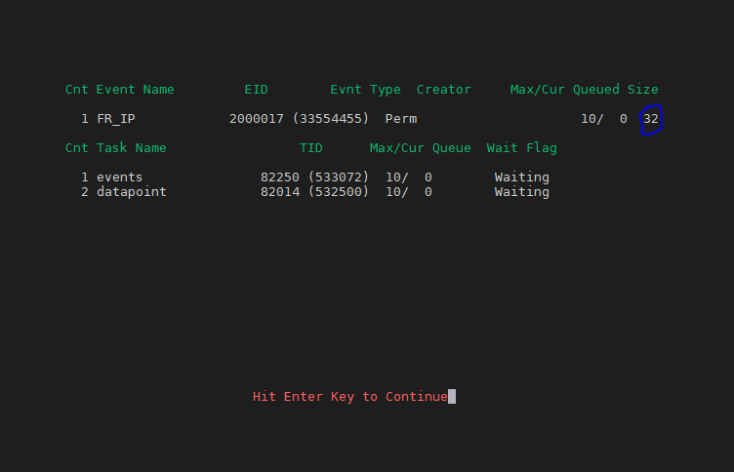
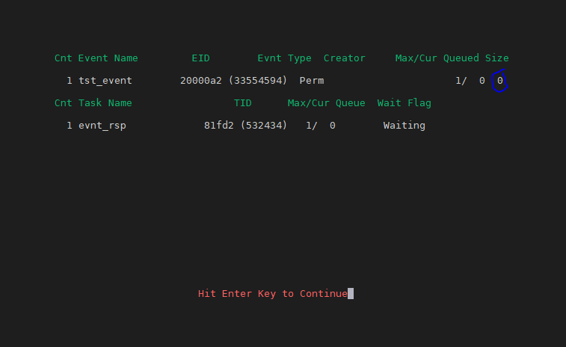
evnt_info
“datapoint isn’t updating the FR_Fuel_rate variable”.
Is datapoint attached to the event?
If it is supposed to be an event with data, what is it’s size?
Have you created a user event before an application could create the event correctly?

Slide 19
errs
The error log is a database that allows the user to look further back in time to find errors
New custom arguments exist to query the database
errs p=cell_mon
Only show errors generated by cell_mon process
errs t=0 c=10000
Show the most recent 10,000 errors. For systems with a lot of errors, you may need to put a very large number for the count (c=)
errs p=<pid>
Useful for seeing only errors from a specific instance of compvar, run_aver, etc

Slide 20
errs – cell_mon
[tc1@awatson specs]$ cat /specs/cmds/old_cell_mon
#!/bin/bash
get_errs p=cell_mon f=/data/errors/cell_mon.$(date "+%d.%m.%y.%s")
[tc1@awatson specs]$ setev abort_limit;date;sleep 1;ls -ltr /data/errors/cell*
Tue May 16 10:28:06 MDT 2023
-rw-rw-r-- 1 tc1 tc1 2271 May 16 10:28 /data/errors/cell_mon.16.05.23.1684254486
[tc1@awatson specs]$ cat /data/errors/cell_mon.16.05.23.1684254486
Error 1232 in: cell_mon TID:532438 On Tue May 16 10:27:25 2023
File: /cyflex/test/monitor/mon_limit.c Line: 597
abort_limit from SET_EVENT - by - by
Error 1232 in: cell_mon TID:532438 On Tue May 16 10:25:18 2023
File: /cyflex/test/monitor/mon_limit.c Line: 597
abort_limit from SET_EVENT - by - by
Error 1232 in: cell_mon TID:532438 On Tue May 16 10:24:36 2023
File: /cyflex/test/monitor/mon_limit.c Line: 597
abort_limit from SET_EVENT - by - by

Slide 21
trace files - grep
Trace files can contain an overwhelming amount of data. The following tips can help:
Capture data when events occur. For example, the following would take a snapshot of the gp_test trace file during an abort limit
Use grep to look for what you want. For example, if you’re troubleshooting problems with HDTranem_main, grep HDTranem_main /specs/gp/trace/test* This gives you a list of timestamped files to look through based on when the issue occurred. If you know the issue is in mode 445, grep HDTranem_main /specs/gp/trace/test* | grep 445 This may help narrow down which files
grep abort_limit /data/errors/er_trace.*
See which er_trace files have abort_limits and who set them, narrow down further by looking at the file timestamped for your investigation

Slide 22
show_mem
Memory is manually allocated in the go script via the sys_start command. If you don’t allocate enough memory, terrible confusing things will happen
show_mem should be at the end of the go script as a “constant reminder”. However, for customers executing many start_xyz scripts that initiate many other cyflex programs which create variables and events, the show_mem output at the end of the go script isn’t an accurate representation of your systems actual required resources
Manually execute when investigating problems that are terrible and confusing. Specifically, events or variables not getting created when they should
k-used should be less than k-available
If you’re getting close in a category, up that value in your go script and run a go for the change to take effect
In newer versions, show_mem generates an error message to the terminal and error log if you’re nearing the memory limit in any category

Slide 23
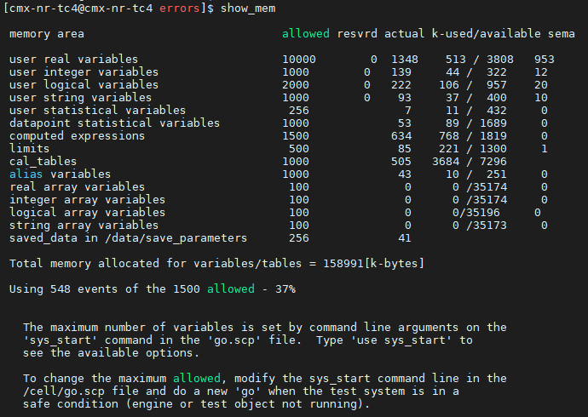
show_mem

Slide 24
/usr/local/bin/analyze-cores
A program should never core dump (segmentation fault), this always indicates a bug. The program should exit ‘gracefully’ with an error message.
A JIRA should be created for any CyFlex application core dumping (while running a new CyFlex release)
You can find them by running ls -ltr /data/errors/*core*
General use case for the analyze-cores program is for a developer to see where in the code the bug is located.
64-bit usage: /usr/local/bin/analyze-cores <core file filepath>
After running this, command you’ll be , a text file will be located in /tmp that starts with gdb. ls -ltr /tmp/gdb*
Attach this file to the JIRA to expedite the software developer isolating/fixing the bug

Slide 25
tcpdump
Terminal equivalent of wireshark for TCP/UDP communication
Can be used as a quick check to see “Is gantner/snap even sending fresh data?”
Changing values generally means the device is sending fresh data. Stale values, no values, or all 0’s generally means nothing is being streamed
Specify the ethernet port for the computer used to talk to the device, and the IP address of the brain/device you want to see the data transfer
sudo tcpdump -X -i <ethernet port> src <IP address>

Slide 26
tcpdump
sudo tcpdump -X -i eth4 src 192.168.222.22
15:54:44.324872 IP 192.168.222.22.5566 > 192.168.222.10.socalia: UDP, length 110
0x0000: 4500 008a 0000 4000 4011 fcf0 c0a8 de16 E.....@.@.......
0x0010: c0a8 de0a 15be 13ec 0076 6460 0000 0000 .........vd`....
0x0020: c853 8e01 265e 7705 0000 0000 265e 7705 .S..&^w.....&^w.
0x0030: 0000 0000 0100 0000 0000 0000 0000 0000 ................
0x0040: 0000 0000 c5eb ae4c 0000 8040 0000 0000 .......L...@....
0x0050: 0000 0000 0000 0000 0000 0000 0000 0000 ................
0x0060: 0000 0000 0000 0000 6c0d 0000 0000 0000 ........l.......
0x0070: 0000 0000 0000 0000 0000 0000 dcb8 0000 ................
0x0080: 40b8 0000 f6b8 0000 2cb8 @.......,.
15:54:44.864414 IP 192.168.222.22.5566 > 192.168.222.10.socalia: UDP, length 110
0x0000: 4500 008a 0000 4000 4011 fcf0 c0a8 de16 E.....@.@.......
0x0010: c0a8 de0a 15be 13ec 0076 6edf 0000 0000 .........vn.....
0x0020: fe53 8e01 ad5e 7705 0000 0000 ad5e 7705 .S...^w......^w.
0x0030: 0000 0000 0100 0000 0000 0000 0000 0000 ................
0x0040: 0000 0000 d6eb ae4c 0000 8040 0000 0000 .......L...@....
0x0050: 0000 0000 0000 0000 0000 0000 0000 0000 ................
0x0060: 0000 0000 0000 0000 6d0d 0000 0000 0000 ........m.......
0x0070: 0000 0000 0000 0000 0000 0000 a0b7 0000 ................
0x0080: 32b9 0000 0839 0000 04b8 2....9....

Slide 27
Computer diagnostics
ifconfig
If you see TX or RX errors, drops, overruns, etc this could be the cause of your IO issue
df -h
Look at the Use% and make sure it’s not 100%
Any and everything can fail when / or /home is at 100%
top
Use this to view processes and get an overview of how much of the computer resources they’re using
You can call it in batch mode from a script if you want to see what it looks like at a particular time, then trigger it based on an event or gp_test mode top -b -n1 | head -n50 >/data/errors/top_output.$(date "+%d.%m.%y.%s")

Slide 28
Computer diagnostics
223.254 MB /opt/google/chrome/chrome
224.238 MB /usr/lib64/libreoffice/program/soffice.bin
233.852 MB /usr/share/teams/teams
286.246 MB runqtui
300.309 MB /usr/bin/gnome-shell
406.98 MB /usr/bin/gnome-software
1374.75 MB /usr/libexec/packagekitd
[tc1@awatson cmds]$ cat where_my_ram
#!/bin/bash
ps aux | awk '{print $6/1024 " MB\t\t" $11}' | sort -n

Slide 29
Troubleshooting process – simple steps
ls -ltr /specs ls -ltr /cell
If you have a problem with subsonic that you just noticed today, and the timestamp on subsonic_specs is from this morning, compare the current file to your most recent backup using diff or meld. diff /specs/subsonic.1 /mnt/TcNfs/my_backup/MON/specs/subsonic.1
or
meld /specs/subsonic.1 /mnt/TcNfs/my_backup/MON/specs/subsonic.1
errs t=0 c=10000 p=subsonic
If your error log is overloaded, this is a quick way to only see subsonic errors going back a long time
Do you THINK the problem occur after updating from version x to version y? Confirm it.
slay_stuff
cd /
sudo rm cyflex
sudo ln -s cyflex.x cyflex
sudo /sbin/ldconfig
go

Slide 30
Troubleshooting process – simple steps
[tc1@livecd specs]$ pwd
/.cellspecs/CMX/1/specs
[tc1@livecd specs]$ ls -ltr gen_labels.1
-rw-rw-r-- 1 tc1 users 30608 May 3 10:21 gen_labels.1
[tc1@livecd specs]$ svn log gen_labels.1
------------------------------------------------------------------------
r2742 | cyflexuser | 2021-05-03 16:50:43 -0400 (Mon, 03 May 2021) | 1 line
incremental changes on 202105031813
------------------------------------------------------------------------
r2728 | cyflexuser | 2021-04-29 22:58:09 -0400 (Thu, 29 Apr 2021) | 1 line
incremental changes on 202104300021
------------------------------------------------------------------------
r2722 | cyflexuser | 2021-04-28 22:58:03 -0400 (Wed, 28 Apr 2021) | 1 line
incremental changes on 202104290021
------------------------------------------------------------------------
[tc1@livecd specs]$ svn diff -r 2742:2728 gen_labels.1
Index: gen_labels.1
===================================================================
--- gen_labels.1 (revision 2742)
+++ gen_labels.1 (revision 2728)
@@ -127,15 +127,6 @@
# end of variable age variables for gp_cyflex_ck
################################################################################
-################################################################################
-# variables for statistics
-#label units format initial_value interval/event hst_flag tolerance
-stat_input m/s 2 - WARP OFF 1.00
--
-
-# end of variables for statistics
-################################################################################
-
# testing for Jordan
#label units format initial_value interval/event hst_flag tolerance
stab_tst none 1 - SLO OFF 1
[tc1@livecd specs]$
From 4-29 to 5-03, the stat_input variable was deleted

Slide 31
Troubleshooting process – simple steps
Did the issue arise after you installed a new pressure transducer?
Is that analog input updating?
When subsonic is started during the go, does it generate errors?
Check the lastgo file
slay subsonic and restart it, check for new errors
Does restarting it make the problem go away?
If yes, the order of the go script may be the problem
Is subsonic updating the variable values at all, or is it just updating variables to an incorrect value?
Have other changes related to subsonic variables been made?
If you’re creating some of the subsonic variables with gen_labels, are these tasks competing to update the same variables?
Is there an ownership issue where compvar (or another application) won’t let subsonic update the variables?
Can you ping it?
The most fundamental and sometimes embarrassing question to answer

Slide 32
Troubleshooting process – simple steps
Are there transmit or receive errors on ifconfig?
Has someone else recently reported a JIRA where a similar bug was confirmed in your CyFlex version?
Do you have another test cell with similar hardware or configuration that doesn’t exhibit the problem?
What is different between the two?
Does another Cummins user have a similar configuration?
Search JIRA for address
Create a floger with relevant variables to see what the data shows when the issue happens
Many control program JIRA’s end up ‘resolved’ by reviewing loggers to find that integral bounds, gains, bumpless transfer, or other configuration issues are causing the undesired behavior

Slide 33
Troubleshooting process – simple steps
Are the events being set that cause the action that you want?
Are the appropriate processes attached to the events they should be?
Are the permissions on the files needed set so the necessary programs can read and execute them?
Is ANYTHING working
link_to_mem errors during the go?
[tc1@awatson specs]$ lsmod | grep srr
srripc 102400 144
Does my subsonic spec file have the same number of entries and format as /cyflex/specs.def/subsonic.def ?

Slide 34
Watchdog trips – what to check
In the test cell:
Did the IO stop updating? Is it on? Power loss?
Was a cable unplugged? Slammed in a door?
Is the NIC failing?
CyFlex troubleshooting
ms_diag is always the starting point
Is a process overrun or stuck in reconfig?
Has a limit been tripped?
limit_rpt
Is an e-stop pushed?
Is there a rolling fire inside the test cell?
errs p=cell_mon
Does cell_mon tell you who did it?
watch -n1 gvar watch_dog
Is the CyFlex watch_dog toggling? * your watch_dog variable may be different
Do the er_trace files in /ram indicate what led to the watchdog trip?
After you execute clear_watchdog does the watchdog start toggling again?

Slide 35
Watchdog trips – false alarms
The last application to have set the abort limit may not be the root cause
limit_rpt will often show an abort_limit from oil pressure as the engine was shutting down. However, a dyno fault may have been the FIRST application to set the abort_limit
When ms_diag shows MANY applications overrun, the system most likely froze
Enable crash dump and use crash to help isolate the program causing the crash
Large file writes (sometimes by CyFlex applications, sometimes by user scripts) can take priority over other applications, ultimately causing systems to freeze. The run_esvd is a common culprit.
Dyno fault from DI
Very common confusing situation will be a dyno fault DI setting an abort limit via evnt_rsp
The fault here could have started with the dyno. OR it could be
The communication between CyFlex and the dyno failed (NIC dropout, faulty cable, un-seated CAT5 cable)
The application in charge of dyno communication failed (ecat_mon, dynlink, gmodbus)

