Slide 1
Phased TIMERS

Slide 2
Phased timers – Why?
The use of multi-core processors has changed how we control the sequence of execution of real-time applications.
In a single core processor, execution sequence can be controlled by priorities. Priorities don’t always work as expected on multi-core processors.
We have mounting evidence that tasks are jumping between cpus on highly loaded systems. This is affecting the order in which tasks execute even if attached to the same timer event.

Slide 3
Phased timers – Why?
Failure of cooperating tasks to execute in the desired order can have undesirable consequences.
Consider a sine wave with a 10 second period generated in gen_labels at the FAS (20ms) rate and captured by floger at the same rate.
Viewed over a long time interval, the resulting data looks as expected.

Slide 4
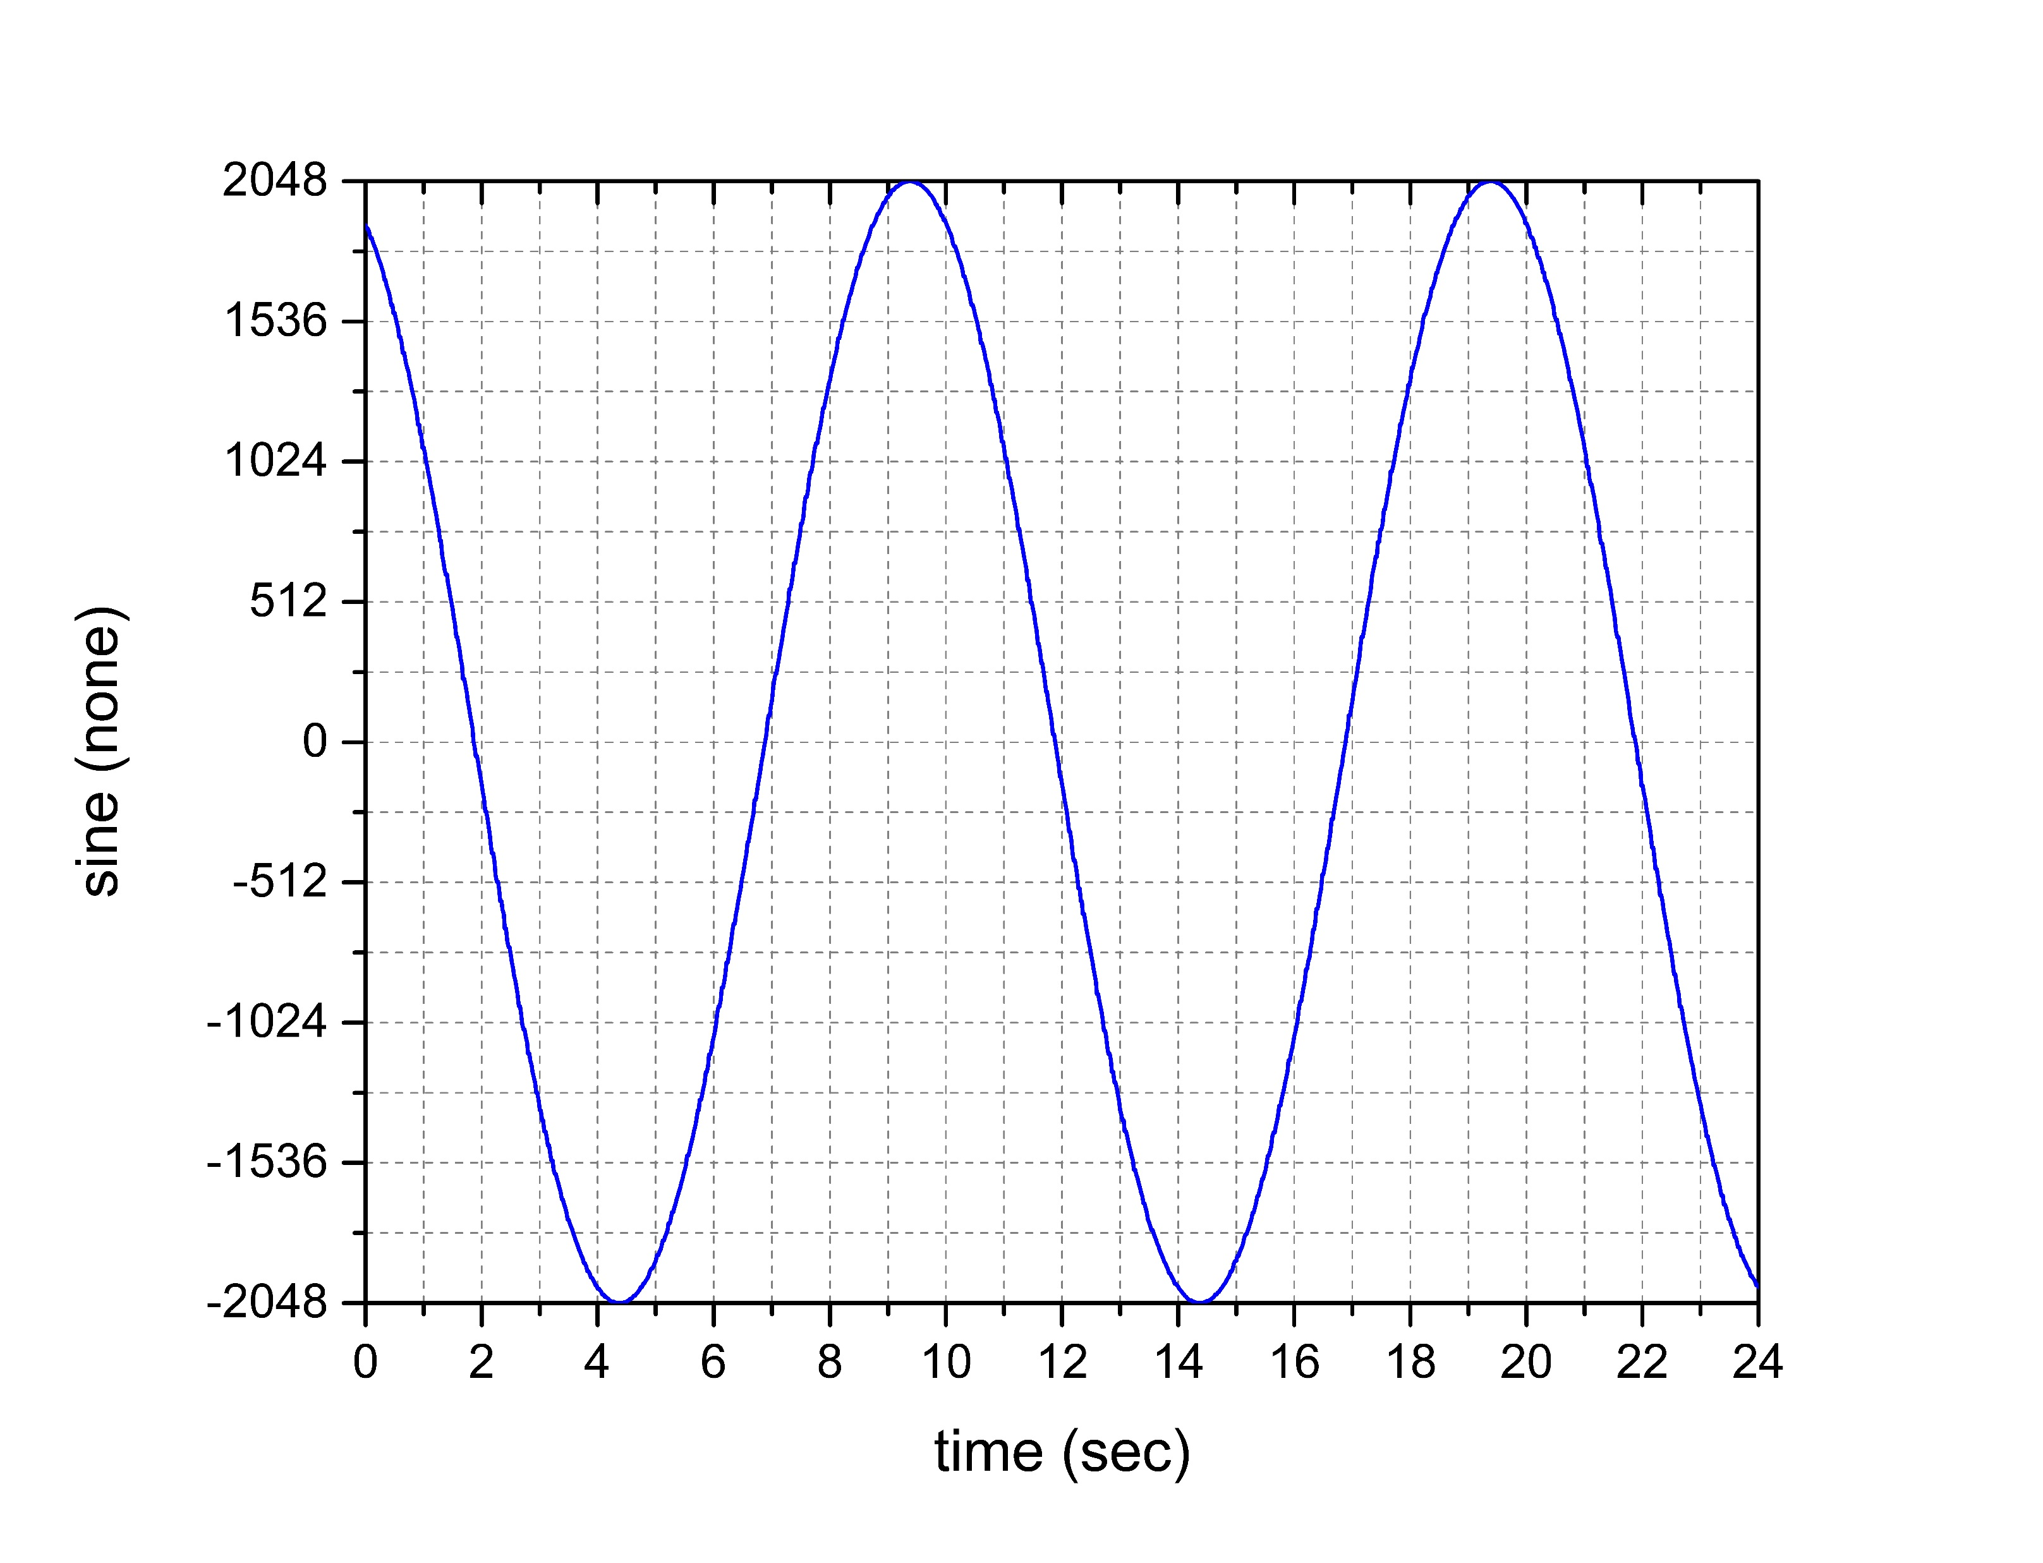
Phased timers – Why?

Slide 5
Phased timers – Why?
But zooming in, we see there are points on the plot where the same value was recorded twice when ‘floger’ captured data before ‘compvar’ updated the sine wave variable.
There are also points where ‘compvar‘ “caught up” and updated the sine wave variable twice before floger had a chance to record the first update of the variable.

Slide 6
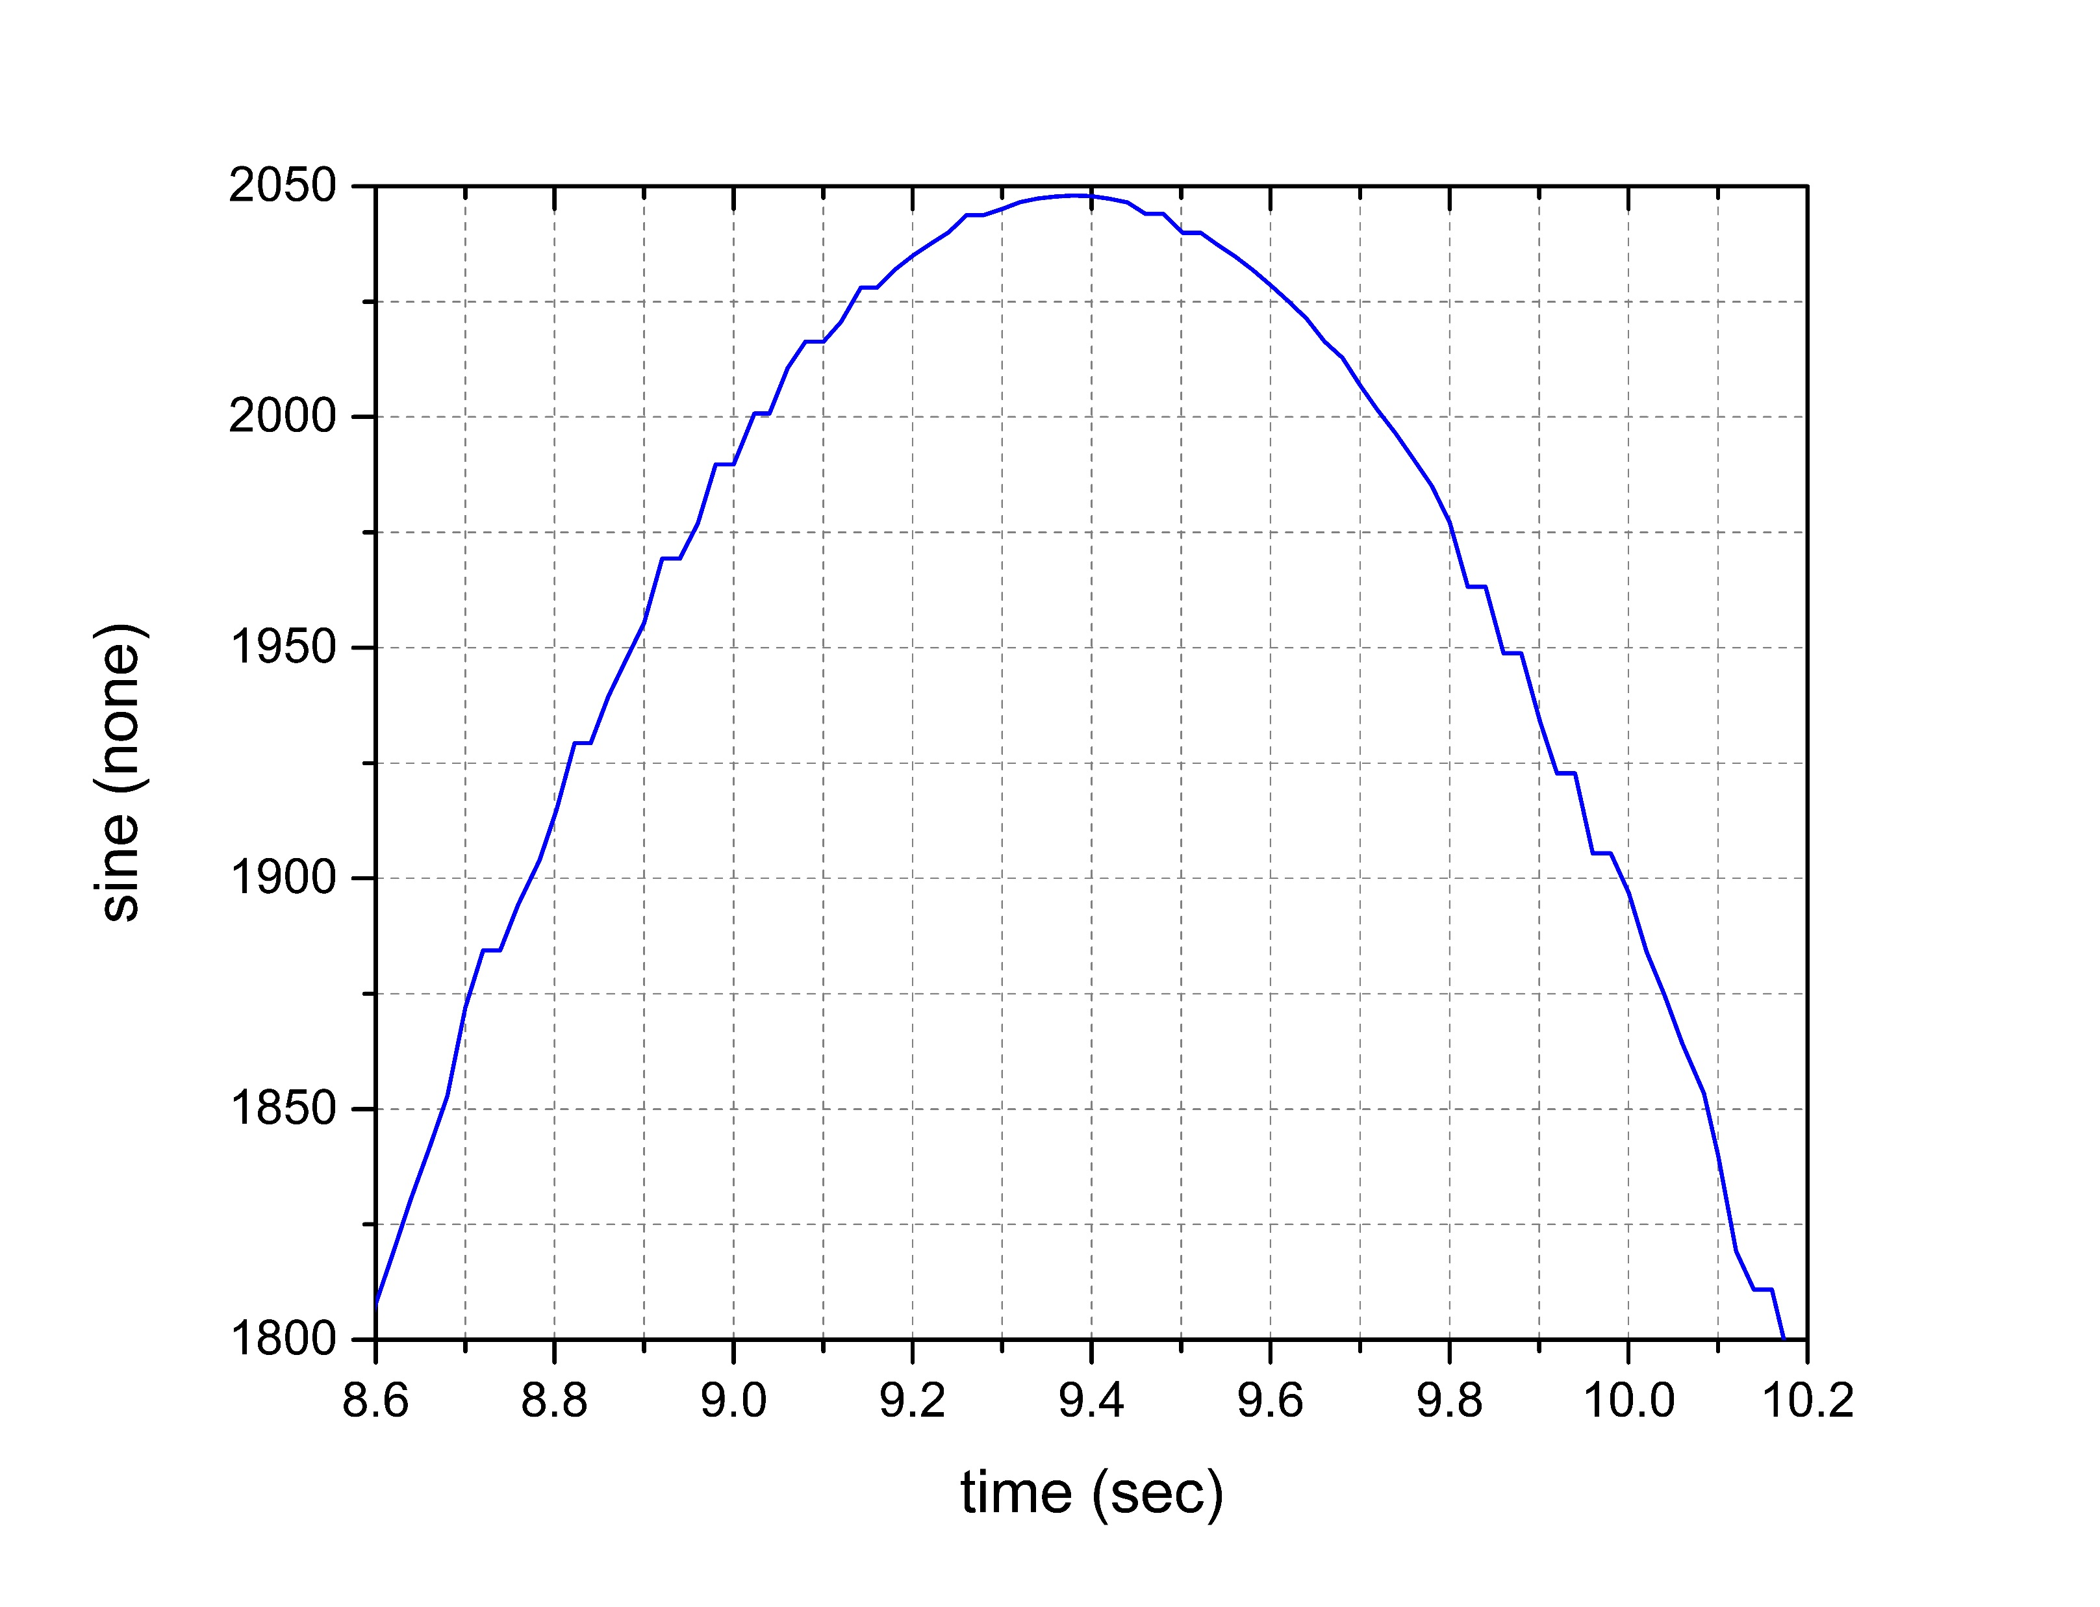
Phased timers – Why?

Slide 7
Phased timers – Why?
Even worse is the effect inconsistent processing order has on the ‘run_aver’ task.
‘run_aver’ uses the timestamp of the variable it is sampling to determine if it has updated and throws away points that appear to be duplicates. So every point that appeared as a flat spot on the ‘floger’ plot would have been thrown out.
It will also fail to capture points that get updated twice before ‘run_aver’ can capture the data.

Slide 8
Phased timers – Why?
As a test, ‘run_aver’ was configured to capture 500 points at the FAS rate (20 ms, 50 Hz) to correspond to one 10 sec sine wave cycle.
It was also configured to oversample at 10 ms intervals so we can be confident every data point will be captured.
Many statistical variables are affected by the failure to execute in a consistent order, but the sample rate (.RA extension) is the most obvious.

Slide 9
Phased timers – Why?
Oversampling prevents sample loss and produces a sample rate (sine_U2.RA) of 50 Hz with a small amount of jitter.
Sampling at the FAS rate (sine_F.RA) shows that samples are being lost and the calculated rate varies as a result.
45 Hz corresponds to ~56 lost samples over the ~11.1 sec required to capture 500 samples.

Slide 10
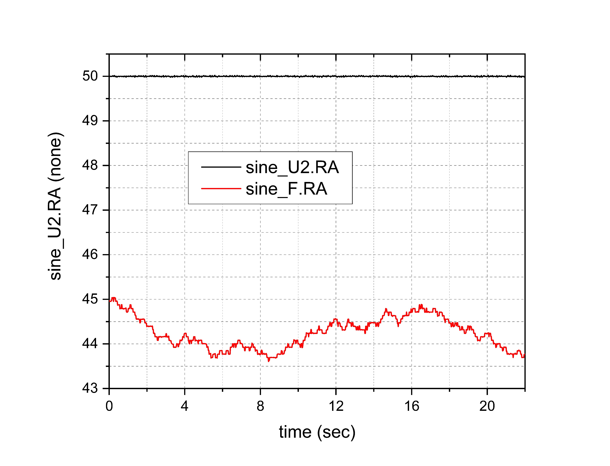
Phased timers – Why?

Slide 11
Phased timers – Why?
The derivative term in the ‘user_ctrl_task’ is also dramatically affected by inconsistent processing order.
Using the sine wave as the feedback variable and specifying a zero target should produce an error whose derivative is a cosine wave.
‘Lost’ samples produce zero derivative terms. Missed samples roughly double the derivative term.

Slide 12
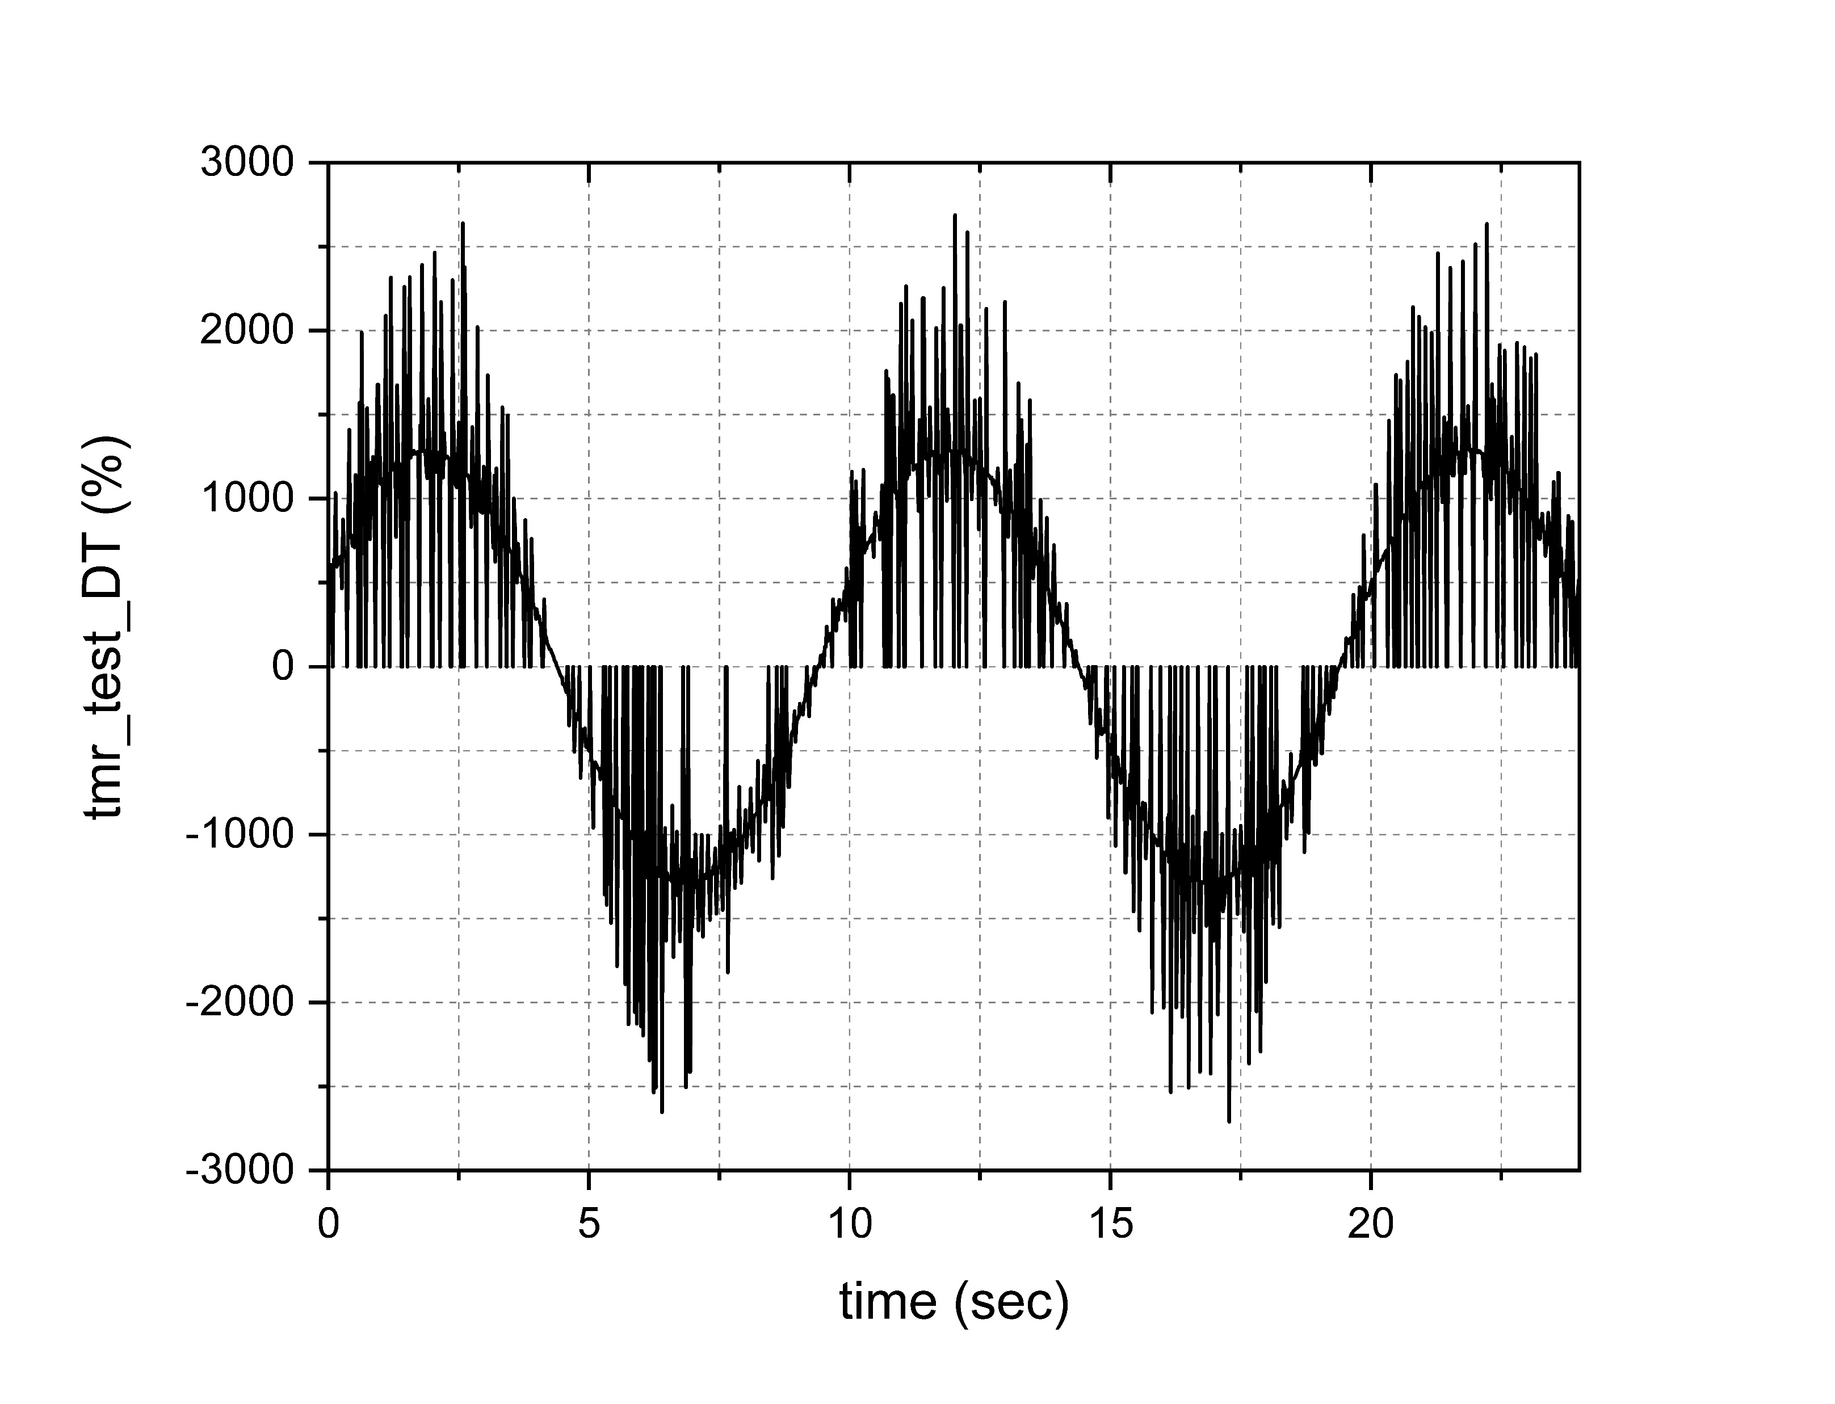
Phased timers – Why?

Slide 13
Phased timers – Why?
We aren’t really taking advantage of more powerful processors if we restrict real-time applications to 1 CPU , so we need another method to control sequence of operations.
We can control the sequence by generating timer events that have a delay, thus giving application A time to complete its operation before application B is signaled to run, even though A&B are running at the same priority and same process interval. The ‘delay’ should be large enough to allow A to complete.

Slide 14
Phased timers – Implementation?
The ‘scheduler’ application creates the new phased timers, but they don’t require command line arguments. They are created automatically.
One additional argument has been added to set the size of the phase shift (delay). PHASING=<size>
Example: scheduler PRI=21 WARP=2 FAS=20 MED=100 SLO=1000 PHASING=1 &

Slide 15
Phased timers – How To USE?
The PHASING ‘size’ value determines the phase shift based on a multiple of the smallest timer interval specified in the launch of the event administrator in the go.scp
Example: evnt_adm 1000 2 & ^-smallest timer[ms]
PHASING size can be 0, 1, 2, 3, etc.
Default PHASING size is ‘1’

Slide 16
Phased timers – How To USE?
There are 3 phased timers for FAS, MED, and SLO
FAS1 – 1 * size_of_smallest interval
FAS2 – 2 * size_of_smallest_interval
FAS3 – 3 * size_of_smallest_interval
MED1 – 1 * size_of_smallest_interval
Etc. for MED1,2,3, SLO1,2,3

Slide 17
Phased timers – Selecting phases?
CyFlex applications that support the standard timers have been modified in 6.3.0 to support the phased timers.
FAS, FAS1, FAS2, FAS3
MED, MED1, MED2, MED3
SLO, SLO1, SLO2, SLO3
Timer names can be used for other applications
tmr-20, ptmr1-20, ptmr2-20,ptrm3-20
tmr-100, ptrm1-100, ptrm2-100, ptrm3-100
tmr-1000, ptrm1-1000, ptrm2-1000, ptmr3-1000

Slide 18
Phased timers – Selecting phases?
We can rerun our run_aver sine wave test with phased timers and compare the result to oversampling.
We find that the sampling rate calculation is very close to 50 Hz for the FAS2 timer but has a small problem when the FAS1 timer is used.
Similar experiments will need to be conducted to ‘dial in’ the phasing process. But we now have a diagnostic to quantify the system response.

Slide 19
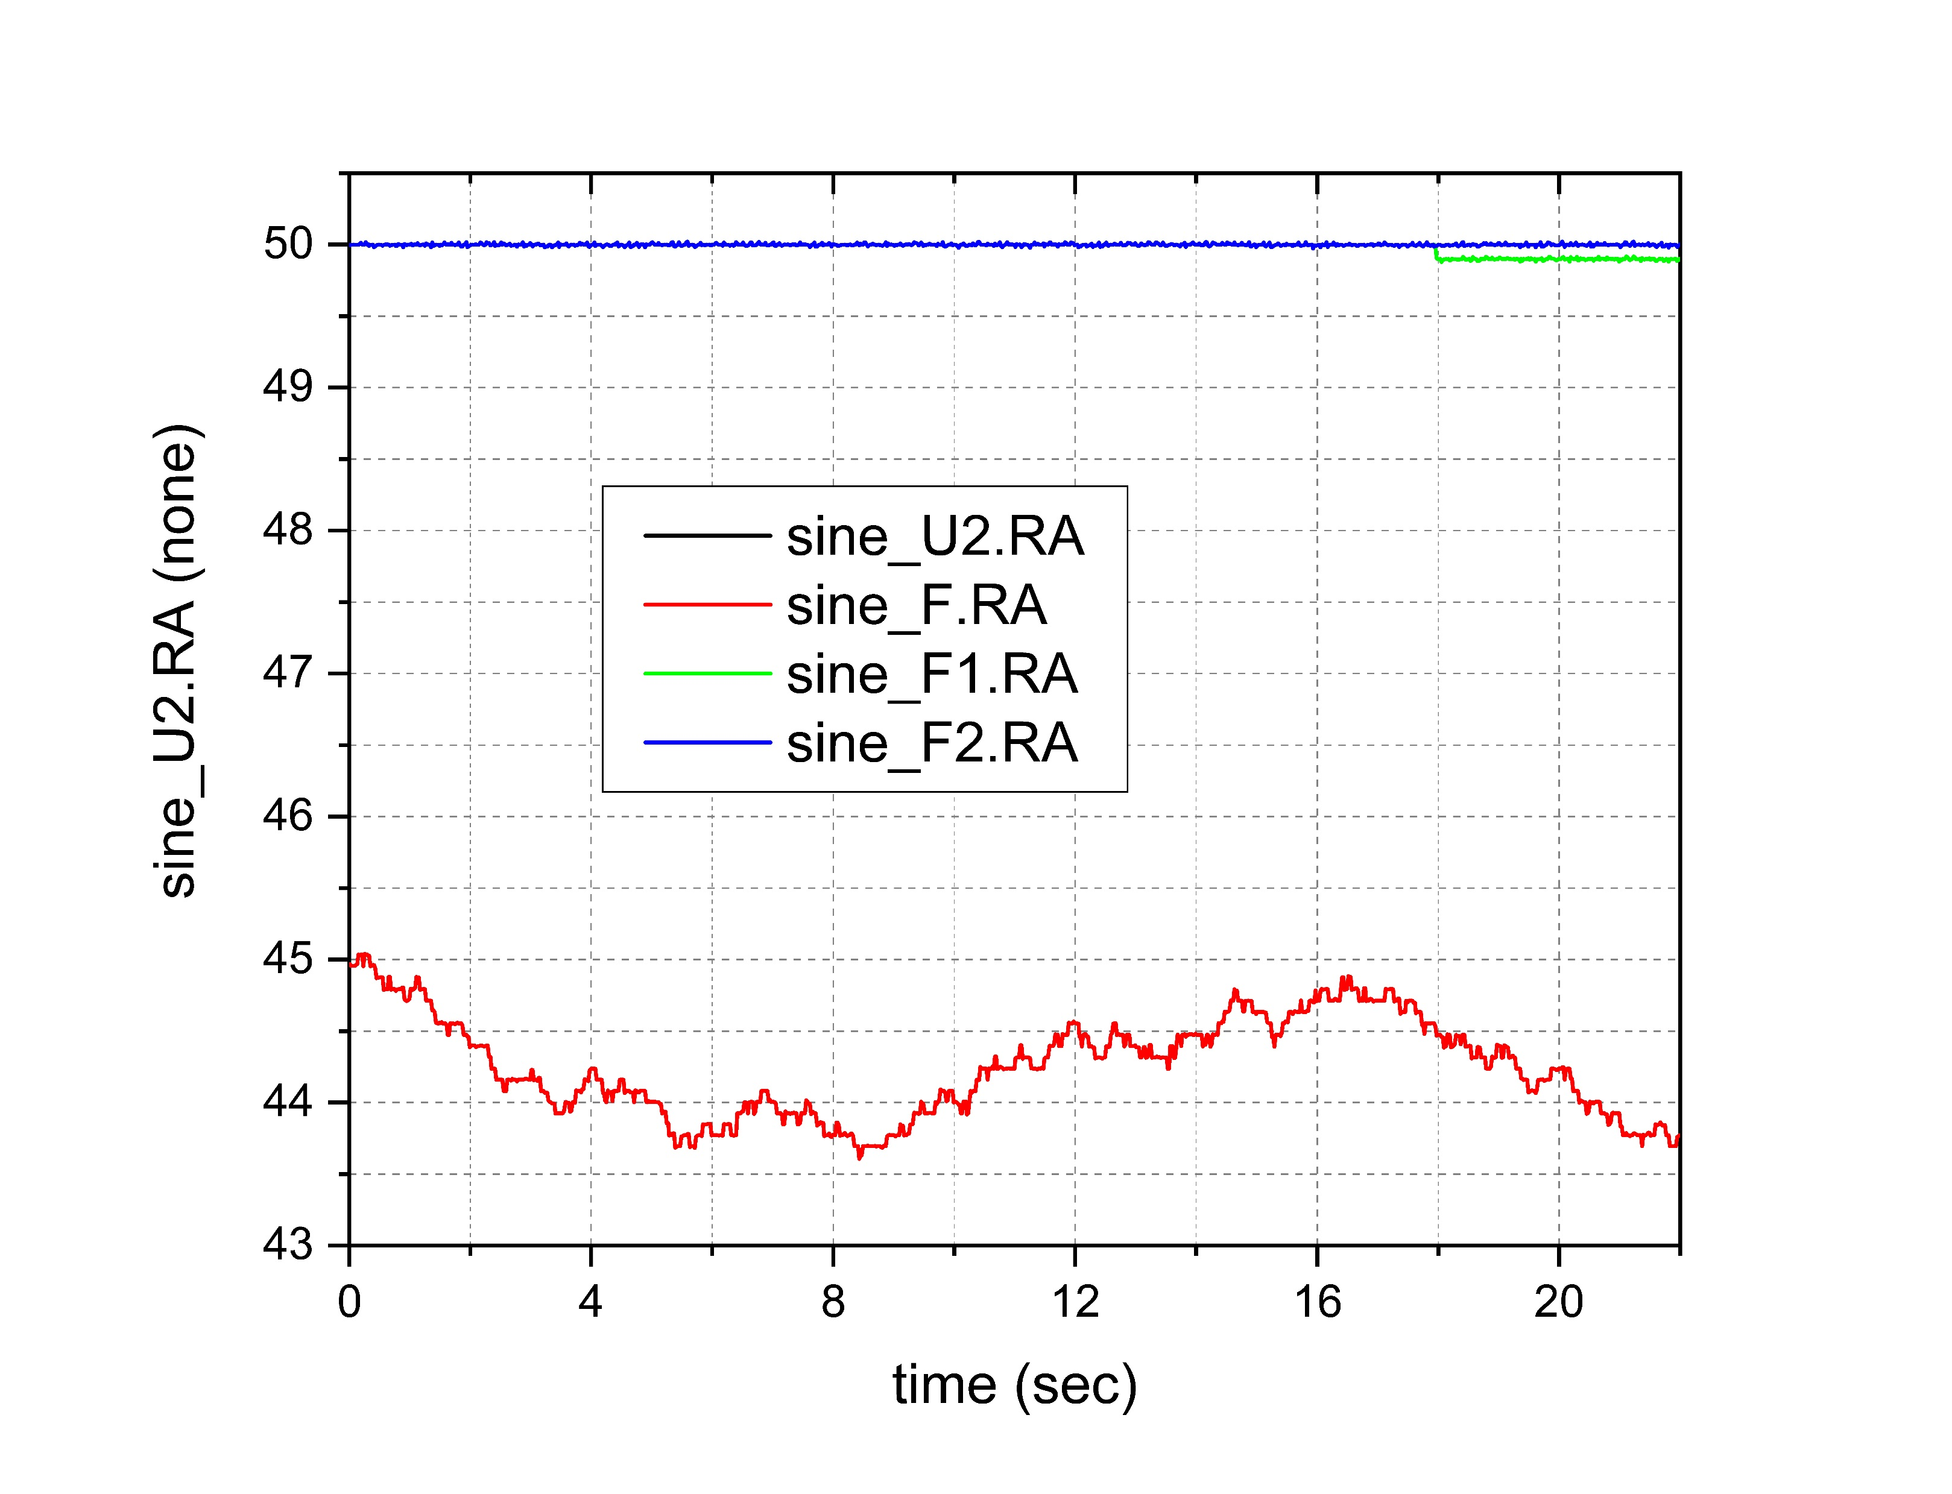
Phased timers – Selecting phases?

Slide 20
Phased timers
Similar improvements are apparent in the derivative term for the user_ctrl_task.
The FAS1 timer still has occasional problems because 2 ms of delay is not always enough.
The FAS2 and FAS3 timers seem to perform well, but there is still ‘noise’ due to the difference between the time compvar updated the sine wave and the system time used by the user_ctrl_task.

Slide 21
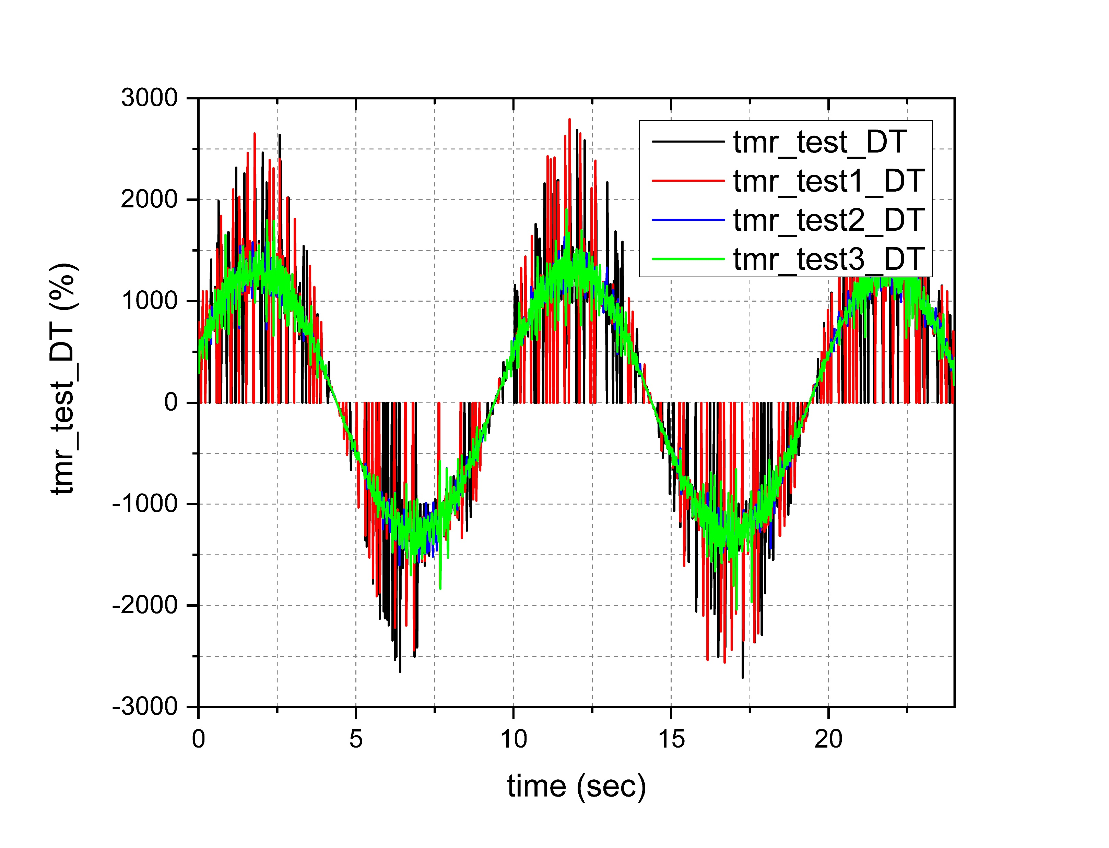
Phased timers – Timer storms?

Slide 22
Phased timers – Timer storms?
During this investigation we noticed another potential problem – all the timers are referenced to the same ‘time zero’.
So if we have timers FAS=10 MED=100 SLO=1000, they will all line up every second.
The FAS and MED timers will all line up every 100 ms.
So every task that is attached to these timers will all be asked to perform their function at the same time.

Slide 23
Phased timers – Timer storms?
This produces a very high momentary cpu load to create what we call a “timer storm”.
For this example case, every application that uses FAS, MED, or SLO would be activated and will be competing for CPU time based on priorities and cpu availability. In multi-core systems, who gets to run first is unpredictable

Slide 24
Phased timers – Why?
A utility called test_ev_time allows us to check the time at which timer events are actually acted upon and compare it to the ideal.
Data captured for a 2 ms timer event shows periodic delays in responding to the timer that suggest that periodic high cpu loads exist that are consistent with a timer storm.

Slide 25
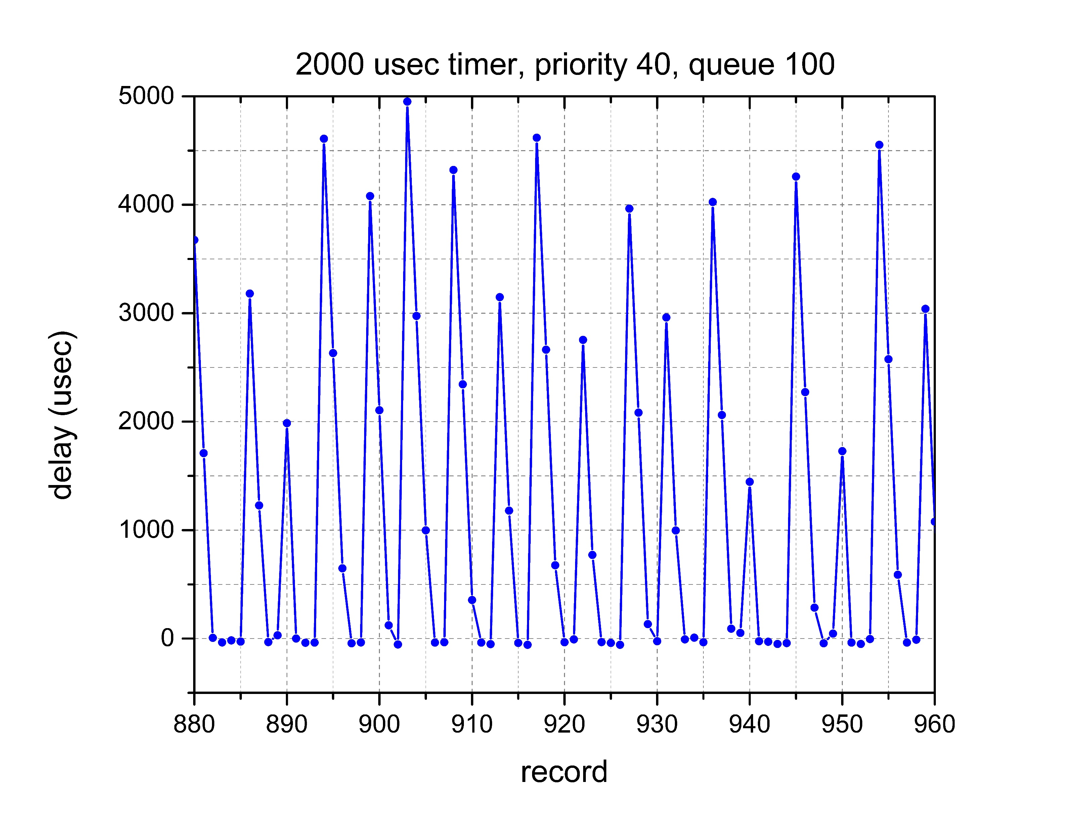
Phased timers – Why?

Slide 26
Phased timers – Timer storms?
In cyflex.6.3.0, the event administrator was modified to allow the shifting of events so that the timer storms can be minimized.
The events for FAS, MED, and SLO will never line up to occur at the same time, regardless of the PHASING value.

Slide 27
Phased timers – Timer storms?
“timer storms” can result in “overruns”. An “overrun” is a case where an application is not able to complete its process before it receives another timer event.
The ‘scheduler’ application keeps track of overruns and has a limiting value for every application and will report an error message if the limit is exceeded. If the application is ‘critical’ the ‘watchdog’ is suspended.
The ‘ms_diag’ utility shows the current state of overruns.

