Slide 1
TRS VISION Test Request Suite – A Tool for Managing Test Requests
By: Your Transportation Laboratories Partners
January 23, 2019
Notes:
PRESENTER: MVH

Slide 2
AGENDA
What is TRS?
TRS Vision(s)
Original
Second
Third
Current
Future
TRI Screen Shots
TRP Outputs
Notes:
PRESENTER: MVH

Slide 3
What is TRS?
TRS (Test Request Suite) is a software suite originally intended to define and execute test requests using CyFlex-automated test systems.
Its parts are:
Acronym | Name | Primary User | Function | Status
TRI | Test Request Interface | test requestors | draft, submit, and revise test plans | in development for initial implementation at CTC EML
TRP | Test Request Processor | test facility staff | export the test plans in a format customized for the target test cell | in development for initial implementation at CTC EML
TRC | Test Run-time Controller | test cell operators | control test sequence and report progress into the TRS data system | development is on-hold
Notes:
PRESENTER: MVH

Slide 4
Original TRS Vision
focus on CTC performance cells
link the definition and execution of tests through electronic means (eliminate paper instructions and manual execution)
ensure test requests are complete (e.g. contains necessary files and logged channels)
consolidate all test request related information into one data system
track changes to test requests
track progress of tests (status and history of activities in each test request)
provide traceability of the test request and execution for years
support interruption of tests, removal of unit under test, reinstallation in an equivalent test bed, and restart the test where it left off
provide a framework that can be reused for various test articles (e.g. engines, turbochargers, aftertreatment, fuel pumps)
provide a flexible framework that can be continually expanded to increase the scope of supported tests without the need for major reprogramming
Notes:
PRESENTER: MVH

Slide 5
Second TRS Vision
shift focus to CTC EML
replace CVS-CI (CVS cell’s Customer Interface for entering test plans)
retain TRC and associated features
Notes:
PRESENTER: MVH

Slide 6
Third TRS Vision
continue focus on CTC EML
drop TRC and associated features
track progress of tests
provide traceability of the test request and execution
support interruption of tests, removal of unit under test, reinstallation in an equivalent test bed, and restart the test where it left off
retain existing test cell software and data flow
replicate existing outputs from CVS-CI
cvs_specs.dat
testmap.txt
test plan cover sheet
test plan printout
create a utility to convert CVS-CI test plans to TRI test requests
add fields for required/desired new capabilities
analyze organization of test request data for a better user experience (i.e. more intuitive) and relative to required/desired new capabilities
Notes:
PRESENTER: MVH

Slide 7
Current TRS Vision
changes in the organization of the test request data rendered TRI incompatible with existing EML test cell software and data flow
replace existing outputs from CVS-CI with equivalent outputs from TRI/TRP
tri_specs.dat
testmap.txt
test plan cover sheet
test plan printout
start with CVS-CI’s two activities
Activity | CVS-CI label | TRI label
run emissions test interval | EPA 1065 | Run ESTTI
manual instructions | Comments | Execute Instructions
add “Activity Group” to TRI to indicate test intervals to run automatically
use TRI to attach ECM cfg and calibration files to test request
add new CyFlex routine to process tri_specs.dat and load into data structures
modify CyFlex to allow array variables to have different units for each element
add new CyFlex routine to load tri_specs.dat data into array variables
modify CyFlex program-based data consumers (e.g. tca and ecg) to read new TRI-specific data structures
modify script-based data consumers to read new TRI-based array variables
Notes:
PRESENTER: MVH

Slide 8
Future TRS Vision
after getting TRI/TRP working for CTC EML
transition all CTC EML CVS-CI users to TRI
adapt TRI/TRP for other test sites using CVS-CI
RMEP is a logical next adopter because of their similarities to CTC EML
HTC@SEP is interested in test cell set-up features more than test sequence
transition all remaining CVS-CI users to TRI and “freeze” CVS-CI
adapt TRI/TRP for other engine emissions test sites not using CVS-CI
explore usage with PUMA-automated emissions test cells
expand TRI/TRP to better support test article prep activities
expand TRI/TRP to support more “activities” for current test function
expand TRI/TRP to support “moveable” test equipment
expand TRI/TRP for other test functions
performance engine test cells
chassis
other test beds, e.g. turbocharger test stands, swirl rigs
develop TRC and associated features including tracking test progress
develop new component of TRS to track test article prep progress
Notes:
PRESENTER: MVH

Slide 9
Future TRS Vision – Hierarchy of Test Bed Functions & Subfunctions and Test Systems (Site, Test Bed Group & Subgroup)
Instance / Enterprise-wide
...
Data (for Subgroup 1)
...
Movable Test Equipment 1
Site 2
Movable Test Equipment 2
Data (for Group 1)
...
Site 1
Movable Test Equipment 1
Data (for Site 1)
Functions
Function 1
Subfunction 2
...
Function 2
...
Group 2
Group 1
Movable Test Equipment 1
Subgroup 1
Test System
Subfunction 1
...
Moveable Test Equipment 2
...
Subgroup 2
Movable Test Equipment 2
...
Movable Test Equipment
Moveable Test Equipment
Movable Test Equipmentt
Notes:
PRESENTER: MVH

Slide 10
Future TRS Vision Test Bed Functions and Subfunctions
Instance / Enterprise-wide
Functions
Engine & AT
Performance
Durability / Break-in
CyberApps
Engine, AT & Alt.
Durability
Engine, AT & Trans.
Performance
Chassis
Performance
Durability / Break-in
Aftertreatment
De-green
Turbo Turbine
Turbo Compressor
Fuel & Lub Chemistry
Fatigue
Test System
Performance
Emissions & FE
Emissions & FE
Performance
Emissions & FE
Notes:
PRESENTER: MVH

Slide 11
Future TRS Vision Sites, Test bed Groups and Subgroups
Instance / Enterprise-wide
STC
...
Data (for CVS)
RTE
Horiba Mexa Bench
CAI Emis. Bench
AVL 415S smoke
AVL 483 soot
RMEP
CAI THC-FID cart
Data (for EML)
Endurance Cells
Cold Cells
Altitude Cell
Tilt Cell
Swirl Rig
Air Flow Stand
CTC
CAI/MKS FTIR cart
Data (for CTC)
Functions
Test System
Performance Cells
EML
AVL 489 PN
CVS
Data (for RTE)
AVL 478 PM
Movable Test Equipment
Moveable Test Equipment
Movable Test Equipmentt
Movable Test Equipmentt
Notes:
PRESENTER: MVH

Slide 12
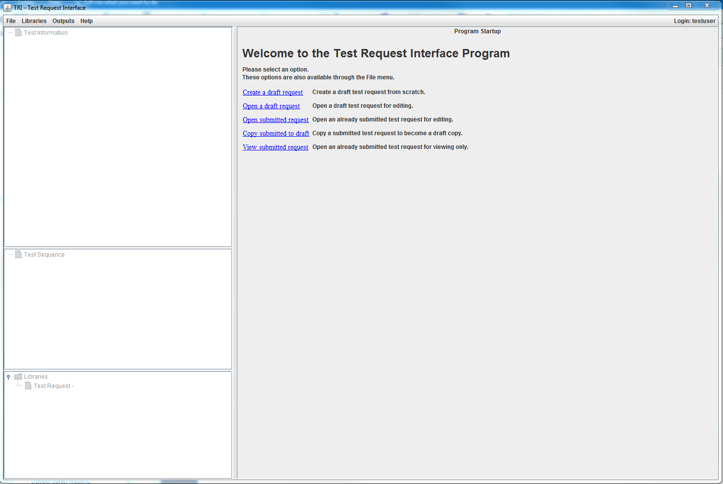
TRI Screen Shots Initial Window
title bar
menu bar
work area
“Test Information” tree – containers and Information screens
“Test Sequence” tree – Activity Groups and Activity screens
“Libraries” tree – library files for saving and replicating screens
Notes:
PRESENTER: MVH

Slide 13
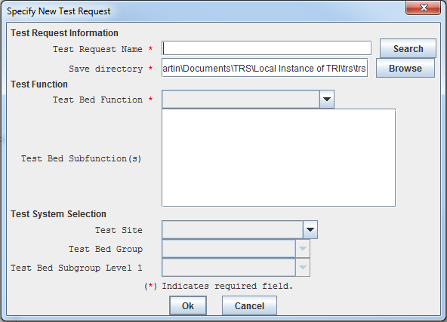
TRI Screen Shots “Create a draft request” opens the “Specify New Test Request” dialog box
user-specified name and location
must select Test Bed Function (and any Subfunction) – this triggers TRI to load applicable screen structure and activity screens
currently the only Test Bed Function is “Engine & AT”
currently the only Test Bed Subfunction is
“Emissions & FE”
may proceed without specifying Test System Selection – must eventually specify and provide any test-system-specific inputs
Notes:
PRESENTER: MVH

Slide 14
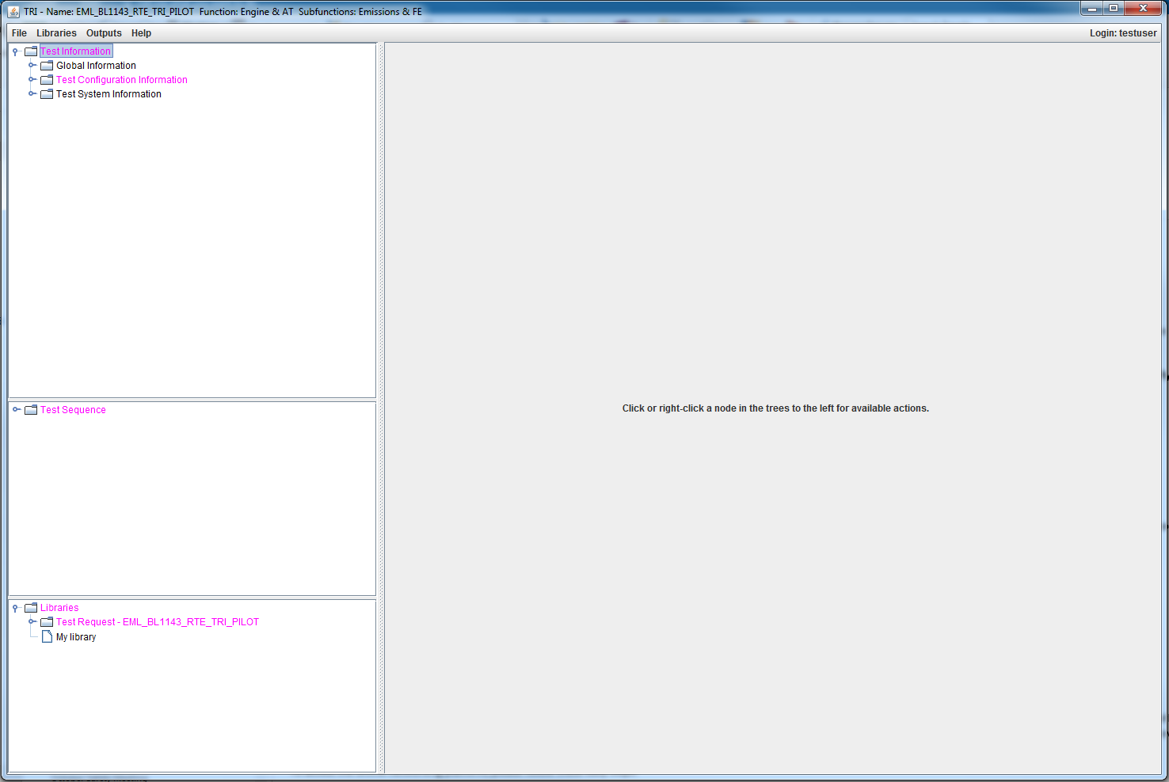
TRI Screen Shots Window after “Open a draft test request”
title bar shows test request name, function, and subfunction
“Test Information” tree – showing the root and next level containers
work area is empty
“Test Sequence” tree – showing just the root
“Libraries” tree – showing a container for the currently opened test request
Notes:
PRESENTER: MVH

Slide 15
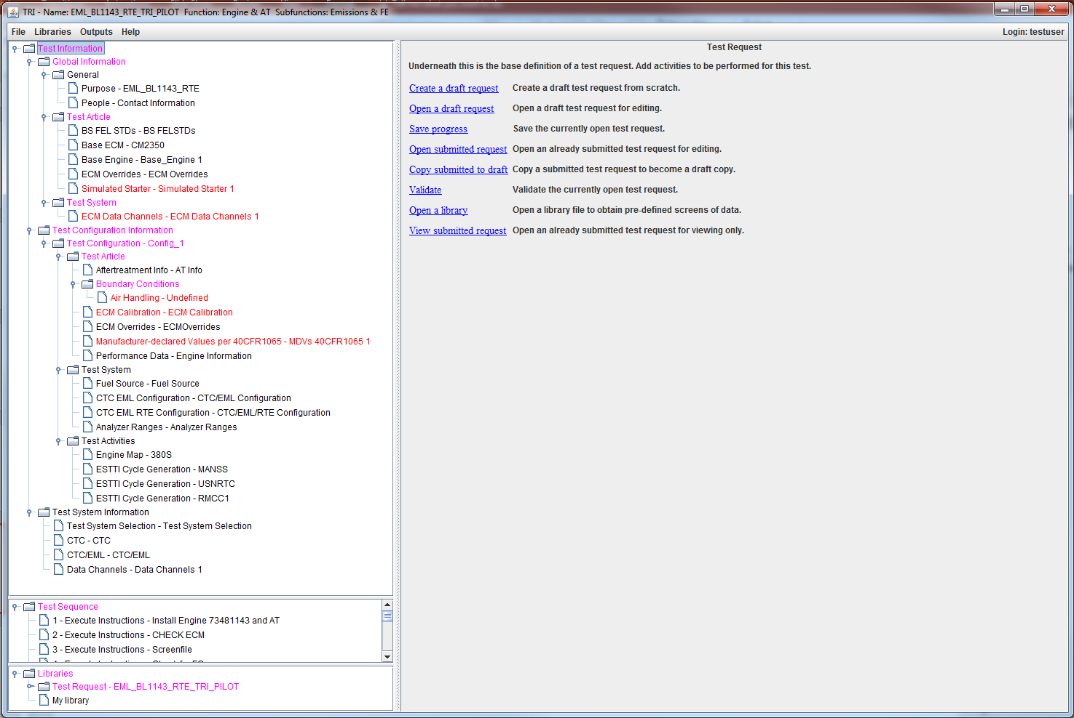
TRI Screen Shots Window after “Open a draft request” and expanding all containers
work area shows information associated with the item selected
“Test Information” tree – shows the root, all containers and all screens
magenta indicates a container with a screen that needs attention
red indicates a screen that needs attention
black indicates containers and screens that have all required inputs
“Test Sequence” tree – shows the sequence of activity screens
Notes:
PRESENTER: MVH

Slide 16
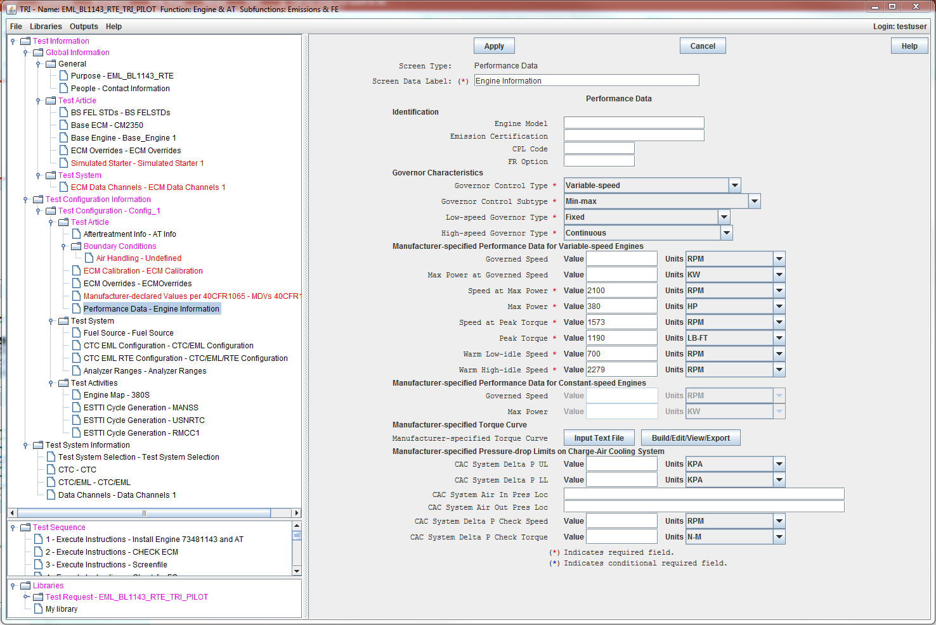
TRI Screen Shots ”Performance Data” information screen – an example
screen level help
Notes:
PRESENTER: MVH

Slide 17
TRI Screen Shots Help for ”Performance Data” information screen – an example
Screen level help can provide enough detail for a novice to understand how each input is used so they can make an informed decision on optional inputs and provide guidance on how to determine required inputs. This example is 11 pages long.
Notes:
PRESENTER: MVH

Slide 18
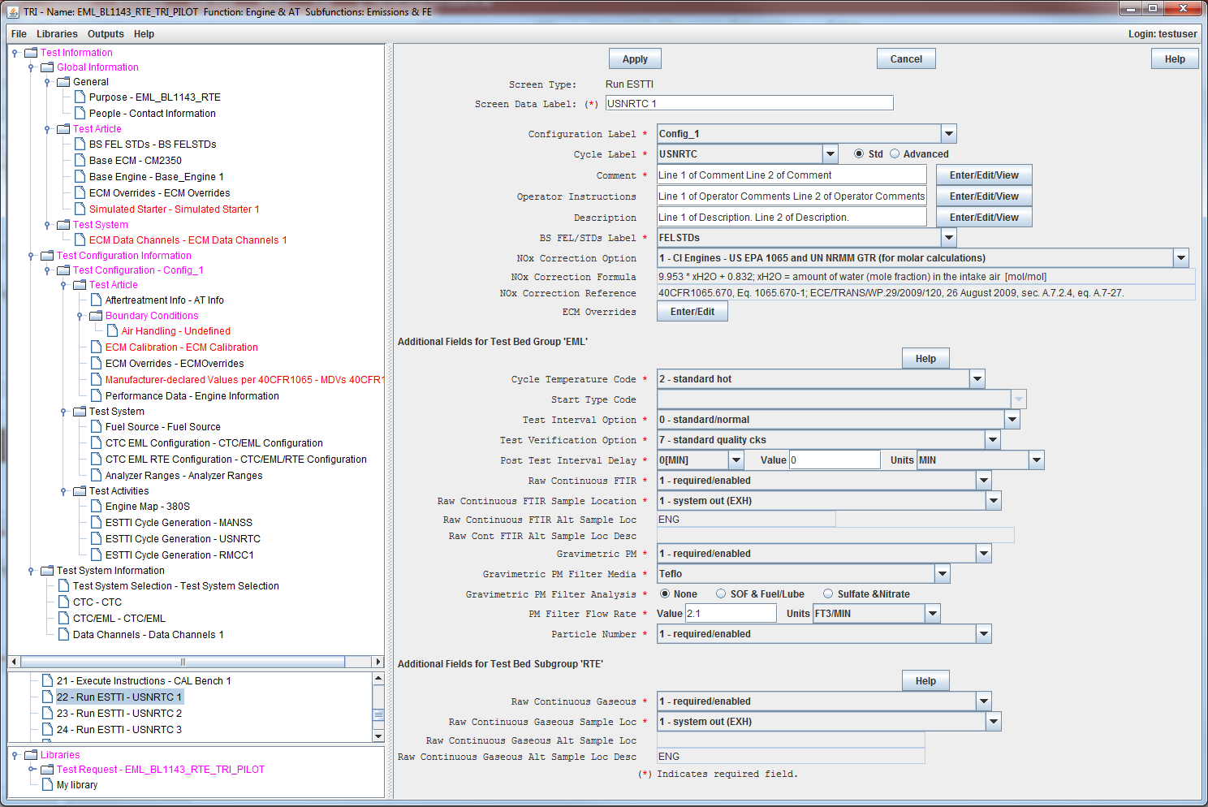
TRI Screen Shots ”Run ESTTI” activity screen – one of two activity screens
test function-specific (i.e. common) fields …
followed by test system-specific fields
EML’s fields
separate help for each section
RTE’s fields
Notes:
PRESENTER: MVH

Slide 19
TRP OUTPUTS
Cover page
replaces cover page from CVS-CI
same file format – html
reformatted for consistency with TRI screens
new fields for engine prep, some reorganization
tri_specs
replaces cvs_specs from CVS-CI
same general format – text file format
new fields, some reorganization, new keywords
Test map
same format as test_map file from CVS-CI – text file format
more fields to better control test sequence
supports next test map (firball) index to execute via TRI “Activity Group”
Test plan
replaces test plan from CVS-CI
same file format – html
reformatted for consistency with TRI screens
new fields, some reorganization
Notes:
PRESENTER: MVH

Slide 20
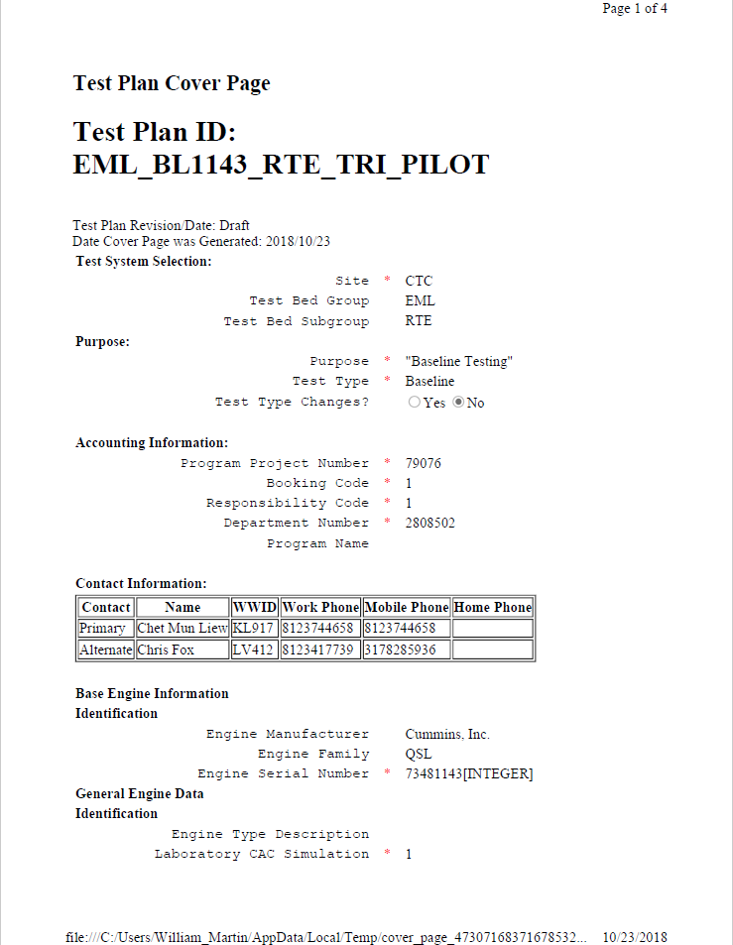
TRI Outputs Cover page – example
This example is 4 pages long.
Notes:
PRESENTER: MVH

Slide 21
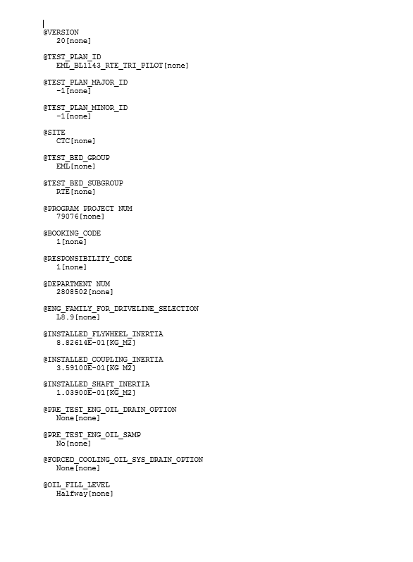
TRI Outputs tri_specs – example
This example is 23 pages long.
Notes:
PRESENTER: MVH

Slide 22
TRI Outputs test_map – example
7 more columns not shown
Notes:
PRESENTER: MVH

Slide 23
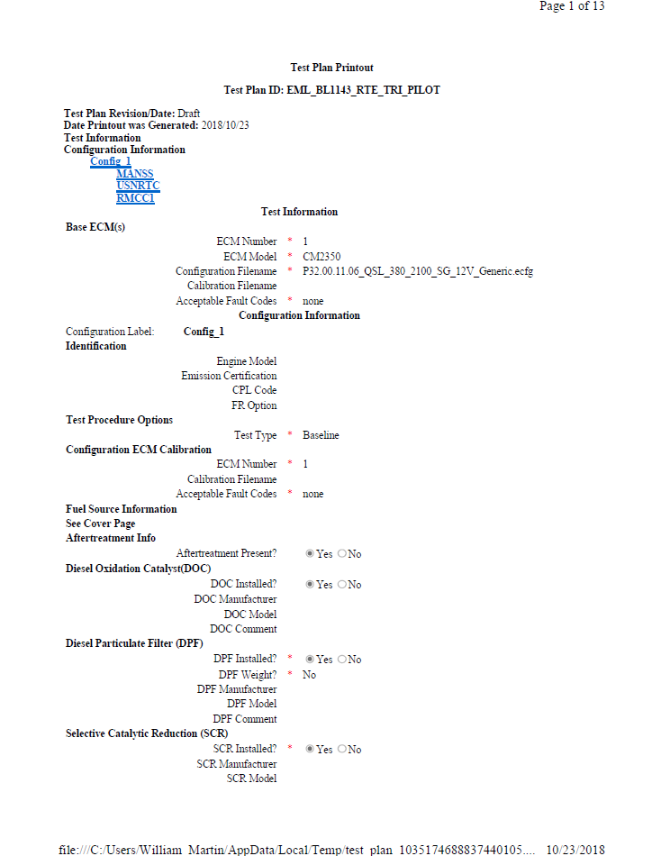
TRI Outputs Test plan – example
This example is 13 pages long.
Notes:
PRESENTER: MVH

Slide 24
END

